Slide 1

Community Paramedicine
Paul Zeeb, MD
November 14, 2018

Slide 2
Definitions
Mobile Integrated Health Care (MIHC) – Mobile Integrated Healthcare (MIH) is the provision of healthcare using patient- centered, mobile resources in the out-of-hospital environment.
Community Paramedicine Evaluation Tool; HRSA March 2012
Community Paramedicine - Community Paramedicine is an emerging field in health care where EMTs and Paramedics operate in expanded roles in an effort to connect underutilized resources to underserved populations.
ACEP Vision Statement on Mobile Integrated Healthcare (MIH) and Community Paramedicine (CP)

Slide 3
Community Paramedicine
There is no:
  National scope of practice
  National curriculum
  Certification exam
Scope of practice defined by ORC & OAC
  Mostly procedural. How about cognitive skills?
“a paramedic may perform….pursuant to the written or verbal authorization of a physician….” (OAC 4765-17-03)
May practice in non-emergent situations

Slide 4


Slide 5
Steps to Implementation
Community Assessment / Business Plan
Scope of practice and authorization to practice
Training program
Protocol
Documentation
Medical Oversight
Metrics

Slide 6

Community Paramedicine
Meeting your community’s needs
Chronic Disease Management
Congestive Heart Failure
COPD
Diabetes
Mental Health
CVA
MI
Joint Implant
Community Service
EMS/engine company, family, community referrals
Link to social services
Lift assists
Overdose/Drug & Alcohol Addiction
Home safety
Who you gonna call?

Slide 7
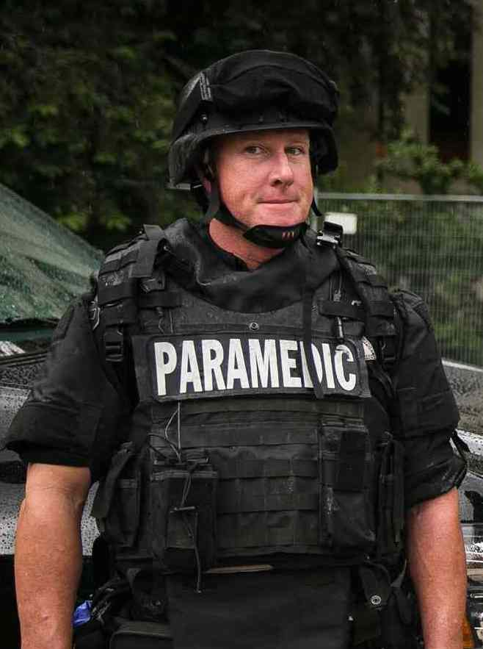

Who Do You Train?

Slide 8

Training Program
Community Paramedicine Academy – 40 hours
Clinical - 232 hours
Rotation | Hours
Street Medicine – Homeless Coordinator What resource are available to the homeless Learn about the barriers of health care for the homeless What communications barriers are present when interacting with the homeless | 16
Mobile Coach Social Work/Case Management What resources are available to income low patients Challenges faced with Non-English speaking patients How to you overcome the health care barriers faced by low income patients | 8
Mobile Coach What are the capabilities and resources provided by the Mobile Coach How do low income and homeless patients access the appropriate health care Psychosocial barriers for appropriate health care in the low income or homeless patients | 16

Slide 9
Continuing Education
Pharmacist
Diabetes educator
Behavioral health
Drug & Alcohol
Chronic disease states (CHF, A. Fib, COPD, 𝛹)

Slide 10
Protocol
Disease entities
  CHF
  COPD
  Diabetes
  CVA/TIA
Post-discharge F/U
Behavioral Health/Overdose
Home safety assessment
Medication Review
Quality of life measures
  Minnesota
  PHQ9
iSTAT
Equipment & Medication
Medical specialty input & shared oversight

Slide 11
What’s Our Process
Patient referral – health care provider, EMS/fire, family or self referral.
Phone call for 1st contact
Hospital discharge follow-up – meet patient before discharge
Dispatched via CAD
2-person 1st contact
Consent for treatment and release of medical information
Treatment plan & documentation via ePCR
Medical director available via cell.
Telephonic or personal report to health care provider as indicated

Slide 12

Documentation
ePCR vs. hand written
Forms
Content and format
HIPAA, BAAs & Consent for Release
Writing skills – “Someone will be reading your reports”

Slide 13
Medical Oversight
This is new for all of us and there is no established chain of command.
Biweekly case review and problems solving
Run audits
Mentorship
Continuing education

Slide 14
Metrics
No shows at Specialty Clinic
Reduction in ED visits
Reduction in total cost of care
Reduction in readmission (30 days)
Primary care physician utilization
Medication inventory
Unplanned acute care use within 6 hours
Satisfaction with community paramedics (survey)
CP best friend of engine company!

Slide 15
http://www.medstar911.org/Websites/medstar911/images/MIH_Metrics_for_Community_Health_Interventions_-_Post_Comments_Revision_CLEAN_4-8-16.pdf

Slide 16
Opportunities – Looking Forward
Primary Care Services (Nova Scotia, Colorado, Minnesota)
Reimbursement for services provided
Collaboration with other EMS providers
  Protocol
  Service agreements
  Training & Continuing Education
Medical Record Integration (CliniSync – Ohio’s HIE)
Recognized EMS specialty
  National curriculum
  Certification exam
  Bachelors or Masters Degrees

Slide 17

Challenges
Perceptions of other health care providers?
Mission creep
Oversight
Documentation
Training logistics
Discharging patients (What’s your end-game JD?)
Compassion fatigue
Metrics – Multiple databases

Slide 18
Resources
Community Paramedicine Evaluation Tool; HRSA March 2012 https://www.hrsa.gov/sites/default/files/ruralhealth/pdf/paramedicevaltool.pdf
ACEP Vision Statement on Mobile Integrated Healthcare (MIH) and Community Paramedicine (CP) https://www.acep.org/globalassets/uploads/uploaded-files/acep/clinical-and-practice-management/ems-and-disaster-preparedness/mih-vision-statement.pdf
Mobile Integrated Healthcare:
A Viable Model for the Partnership of Ohio’s Healthcare System with Ohio EMS ; Ohio EMFTS Board February 2018
http://www.ems.ohio.gov/links/emsMIHC-ModelForPartnership.pdf

Slide 19
Resources
Community Health Needs Assessments: Resources for Community Paramedicine & Mobile Integrated Healthcare; NASEMSO CP-MIH Committee May 2017 https://www.nasemso.org/Projects/MobileIntegratedHealth/documents/CHNAs-Resources-for-CP-MIH-08May2017.pdf
National Consensus Conference on Community Paramedicine: Summary of an Expert Meeting NAEMSO-NOSORH Joint Committee on Rural Emergency Care; October 2012 https://www.nasemso.org/Projects/RuralEMS/documents/AHRQ-CP-Report-07Mar2013.pdf
Doing it Right; JEMS December 2015 http://www.jemsdigital.com/jems/201509?pg=73#pg73

Slide 20
Thank you!
Questions?

