Slide 1
Other Special Pathogen Response (Ebola)

Slide 2
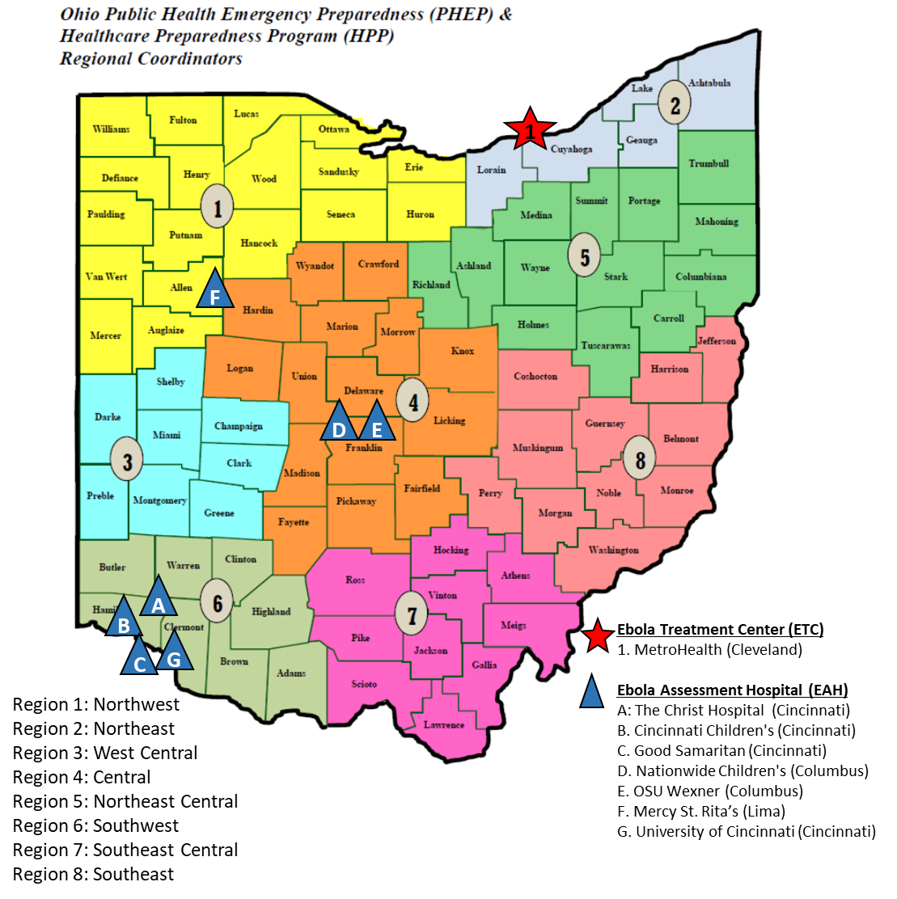
The Plan
Ebola Virus Disease (EVD) is a rare and deadly disease most commonly affecting people and nonhuman primates (monkeys, gorillas, and chimpanzees). It is caused by an infection with a group of viruses within the genus Ebolavirus.

Slide 3
Ohio Emerging Pathogens Coalition (OEPC)
The OEPC is coordinated by the Ohio Hospital Association (OHA) and includes member from hospitals (frontline, EAH, and ETC), local and regional public health departments, local Emergency Medical Services (EMS), and state level agencies (the Ohio Department of Health and Ohio EMS). The OEPC meets quarterly to coordinate planning, training, and exercise efforts across Ohio.

Slide 4
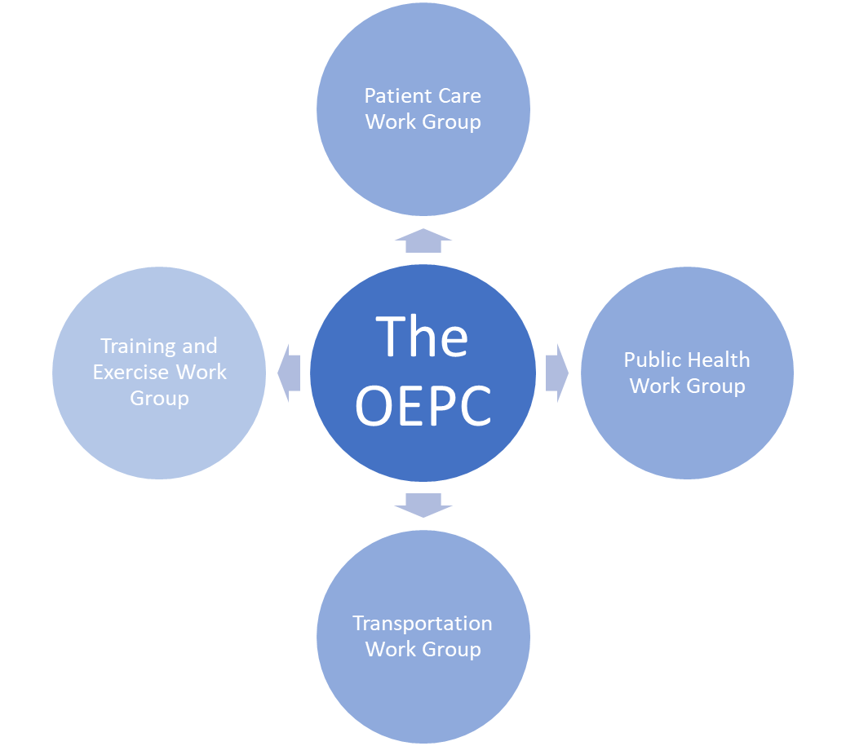
4 Workgroups
Patient Care
Training and Exercise
Public Health
Transportation

Slide 5
Transport
All transports are from the local level. CDC has developed guidance for EMS providers that includes patient assessment, safety and PPE, patient management, transport, and decontamination.
The transportation of persons under investigation (PUIs) or patients will be managed through EMS at the jurisdictional or local level depending on how the EMS system is regulated or controlled in the jurisdiction. Local EMS must prepare for PUIs or a patient, or patients coming from within the EMS system (9-1-1/PSAP calls); an interfacility transfer; or from a port of entry, such as an airport.

Slide 6
The CDC has developed guidance for EMS providers
Patient assessment, safety and PPE, patient management, transport, and decontamination and is working on guidance about interfacility transport. Guidance at the jurisdictional level might be stricter. The EMS medical director for the local EMS agency or jurisdiction can help develop plans on how the jurisdiction will:
Provide guidance to 9-1-1 PSAPs about protocols for identifying calls related to people at risk for contracting Ebola.
If necessary, coordinate with adjacent states to allow EMS to transport patients confirmed with Ebola through the state to Minnesota.
Coordinate with EMS to support the airport and with airport managers in situations where a PUI or confirmed patient is transported by air.
Coordinate EMS for intrastate facility-to-facility transfer (e.g., frontline hospital to assessment or treating hospital).
Coordinate with EMS agencies to develop procedures and arrange for a transfer between two EMS vehicles to reduce long transport times.

Slide 7
Transportation Considerations
Medical Control
Remain with the medical director of the transporting EMS agency.
Physicians from the ETC or the EAH should be available for consult during transport, but ultimate decisions making authority lies with the EMS agency’s medical director.
Chase Car
Ohio EMS has adopted the CDC’s guidelines for a ‘chase car’ while transporting a patient. In some regions this ‘chase car’ will consist of another ambulance.
Transport vehicle breaks down
EMS crew should call the destination facility for assistance.
If the destination facility cannot assist, the EMS crew can contact the ODH 24/7 number (614-722-7221) to notify EMS transport agencies that are approved to transport patients when traveling through the area.
The local jurisdiction where the breakdown occurs must also be notified, including police, fire, EMS, and HAZMAT.
Procedures for the breakdown of an EMS vehicle will be discussed during the Patient Transportation call.

Slide 8
Transportation Considerations—Continued
Patient death during transport
EMS crew will follow normal protocols and procedures for a death during transport; unless they are closer to their originating location. In that situation, the EMS crew will turn back to minimize the time the crew spends with the infectious body.
Driver PPE
EMS – Recommend that driver not be in PPE (safety issue) although some may still prefer to wear PPE.
Notify the Ohio State Patrol (OSP) when transporting across regions as an FYI.

Slide 9
Transportation Considerations—Continued
Drive time/crew rotation (restroom needs?)
Driver/provider becomes ill/incapacitated
Refueling process
“Wet patient” versus “dry patient”
Spill (vomiting, diarrhea) in ambulance
Caregiver (e.g., parent/guardian) accompanies patient?
Post-transport decontamination
Communications with public health, medical director, receiving hospital, et al (Commo Plan)

Slide 10
Transport Plan Exercises
https://repository.netecweb.org/collections/show/3
Highly Pathogenic Infectious Disease Exercise Planning for Regional Transport webinar, 8-23-2017
Regional Transport Ebola Tabletop Exercise Template
Regional Transport Special Pathogen (Airborne) Tabletop Exercise Template

Slide 11
Guidance Document June 2019
Guidance Document for the Management of Suspected and Confirmed Cases of Ebola in the State of Ohio
June 3, 2019
This State of Ohio publication was supported by the Cooperative Agreement Number EP-U3R-15-002 funded by the U.S. Department of Health and Human Services, Office of the Assistant Secretary for Preparedness and Response (ASPR).

Slide 12
Bioquell® BQ-EMS
Bioquell® BQ-EMS provides a mobile system to eliminate pathogens in EMS transport vehicles
Eleven units purchased; located at hospitals:
St. Rita Medical Center
University of Cincinnati Medical Center
Marion General Hospital
Adena Regional Medical Center (Chillicothe)
MetroHealth Medical Center (Cleveland)
6 hospitals are reviewing agreements
Check in-service status

Slide 13
Next Steps
Full Scale Exercise March 10-12, 2020
Activate situational awareness systems to share information and coordinate the response
Implement emerging pathogens coordination procedures
Respond to a medical surge of infections patients
Day 1- Movement of patient from FL to EAH
Day 2-EAH activation
Day 3-Movement of patient from EAH to ETC
GLHP Region V Ebola Transportation and Coordination Exercise February 2020

