Slide 1
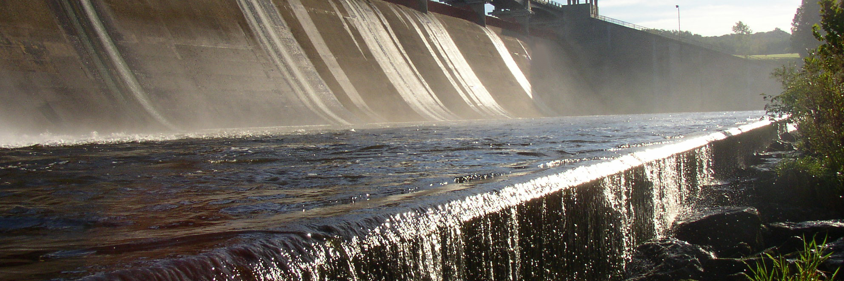



Central Ohio Regional Water Study
Integrated Water Resources Model Approach (OASIS)

Slide 2
Table of Contents
OASIS overview and model components
Model scenarios
Ground water supplies
Surface water supplies and reservoirs
Water treatment plants
Wastewater treatment plants
Drinking water demands

Slide 3
OASIS Overview and Model Components

Slide 4

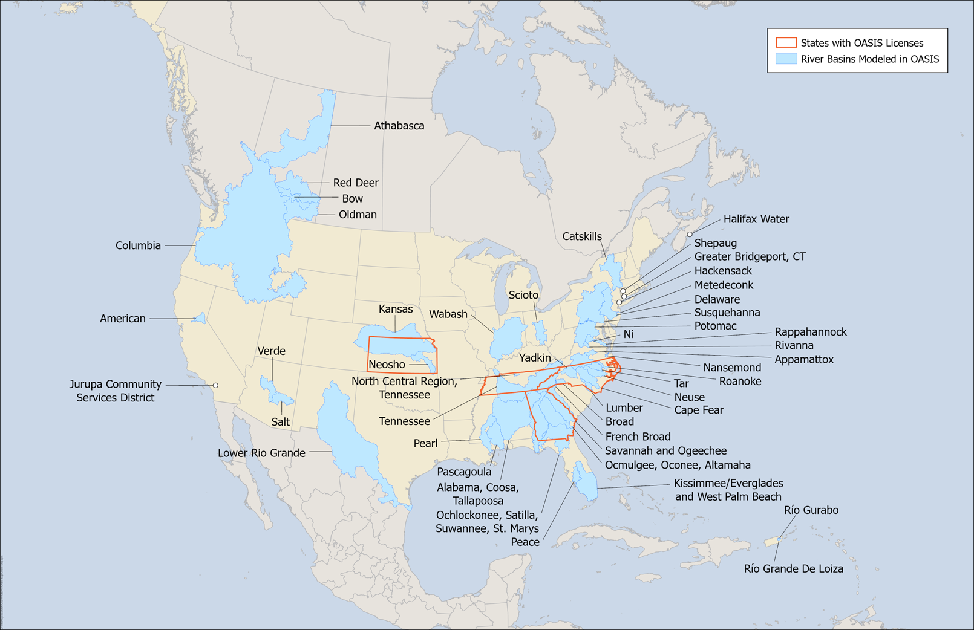
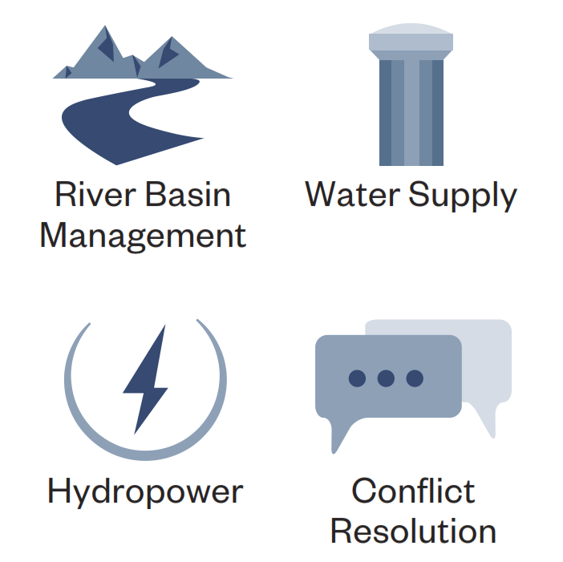
OASIS Overview
Operational Analysis and Simulation of Integrated Systems
A mass balance water accounting model
Captures physical elements and operating rules of the system
Typical Applications:
Collaborative Decision Making

Slide 5
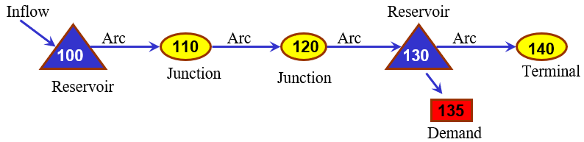
What OASIS Does and Role of Constraints and Goals
Inflow
Reservoir
Arc
Arc
Arc
Arc
Reservoir
Junction
Junction
Terminal
Flow through arcs
Volume stored in each reservoir
Delivery (volume) allocated to each demand node
… calculated every timestep for the period of record
Demand
A linear programming solver
is called every time step
You specify what to do but not how to do it.
The solver is a “smart operator” that obeys the laws of physics (and other specified constraints) while aiming to achieve water supply goals.
Constraints: rules that OASIS must obey
Goal: rule that OASIS tries to meet

Slide 6
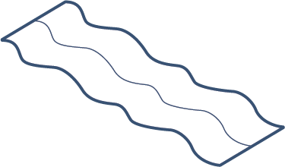


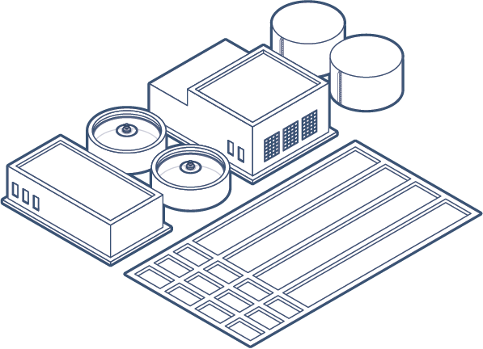
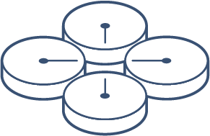



Central Ohio Regional Water Study
Model Components
Surface water supplies
Surface water supplies
Wastewater treatment plants
Water treatment plants
Reservoirs
Ground water supplies
Ground water supplies
Water demands

Slide 7
Model Scenarios

Slide 8
Planning for Multiple Future Scenarios Reduces Risk of Failure
Best Case
A
Present
Plausible Futures
B
C
Worst Case
Time

Slide 9
Model Scenarios
Water Demand Pressure
The four scenarios shown here were run in OASIS across a
25-year planning horizon
Demands with expected growth
Intense Pressure
Full Speed Ahead
Raw Water Supply Availability
5th / 95th percentile precipitation/temperature change factors
50th percentile precipitation/temperature change factors
Easy Does It
Resource Abundance
Demands with historical baseline growth

Slide 10
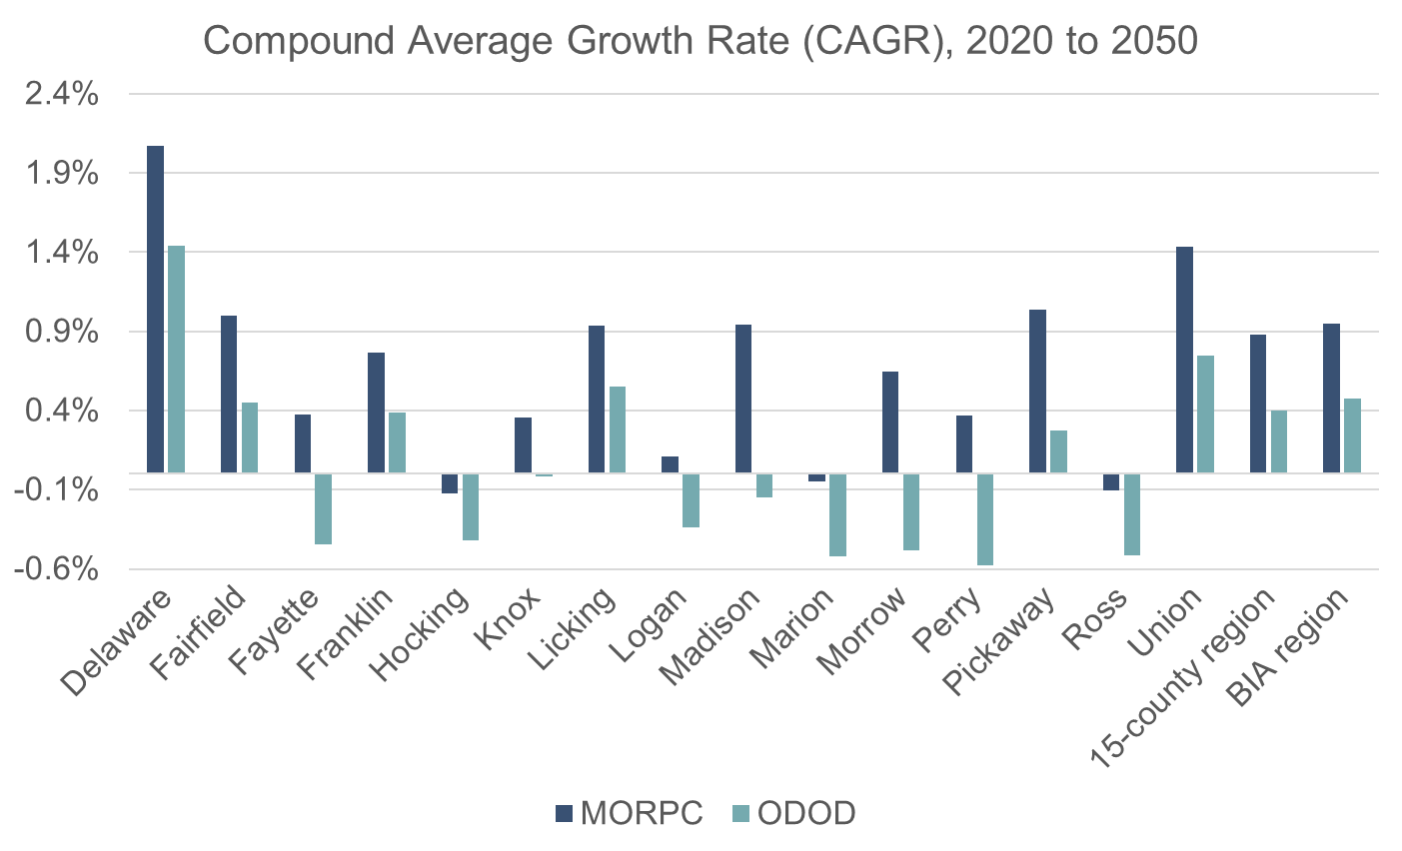
Scenario Planning
Population Growth
Two population projections considered
  Historical baseline growth informed by Ohio Department of Development (ODOD). This projection uses historical growth trends and projects those into the future.
  Expected growth informed by the Mid-Ohio Regional Planning Commission (MORPC). This projection uses land use and zoning plans to estimate population growth.

Slide 11
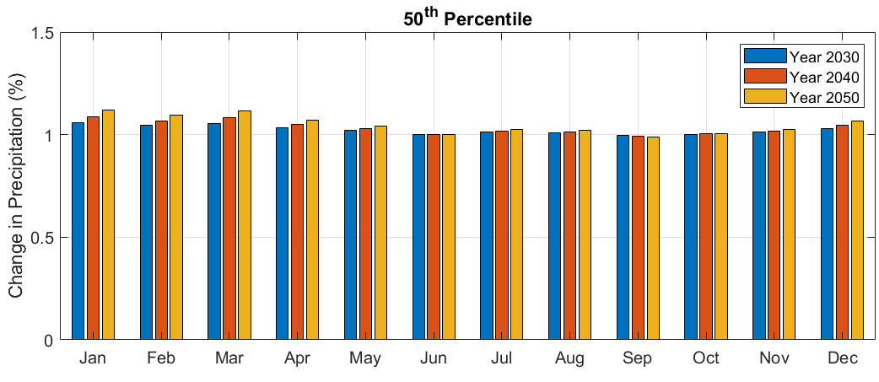
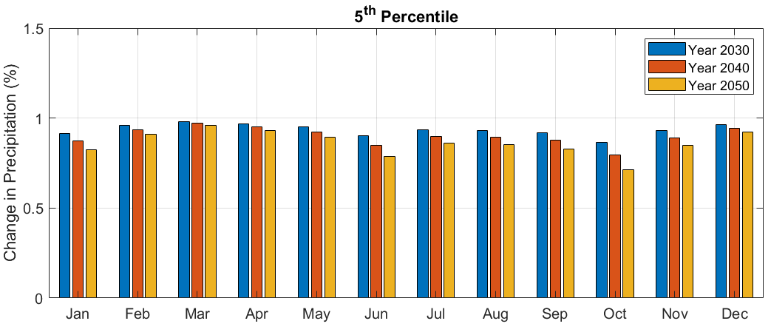
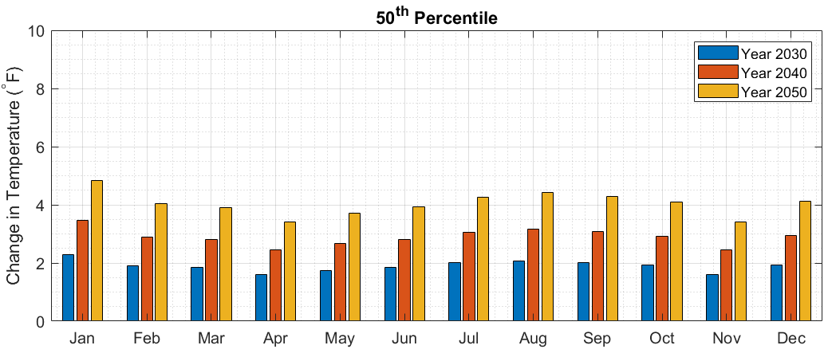
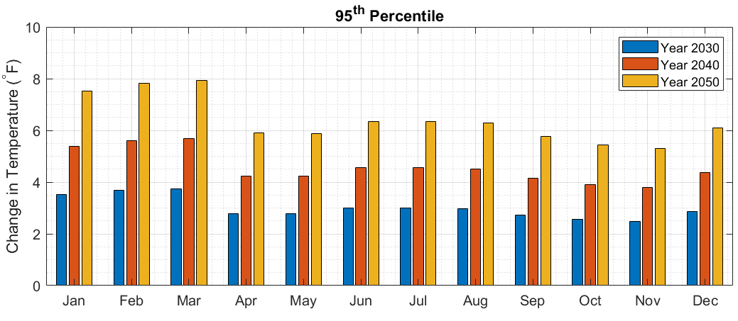
Future Scenarios – Temperature and Precipitation Change
DRAFT
Moderate Change (50th Percentile Temperature and Precipitation)
Extreme Change (5th Percentile Precipitation and 95th Percentile Temperature)

Slide 12
List of Model Scenario Runs
Population Growth Trend | Temperature/Precipitation Trend | Model Year
Expected Growth Trend | None | 2030
Expected Growth Trend | None | 2040
Expected Growth Trend | None | 2050
Expected Growth Trend | 50th Percentile | 2030
Expected Growth Trend | 50th Percentile | 2040
Expected Growth Trend | 50th Percentile | 2050
Expected Growth Trend | 5th/95th Percentile | 2030
Expected Growth Trend | 5th/95th Percentile | 2040
Expected Growth Trend | 5th/95th Percentile | 2050
Population Growth Trend | Temperature/Precipitation Trend | Model Year
Historical / Expected (Base) | None | 2021
Historical Growth Trend | None | 2030
Historical Growth Trend | None | 2040
Historical Growth Trend | None | 2050
Historical Growth Trend | 50th Percentile | 2030
Historical Growth Trend | 50th Percentile | 2040
Historical Growth Trend | 50th Percentile | 2050
Historical Growth Trend | 5th/95th Percentile | 2030
Historical Growth Trend | 5th/95th Percentile | 2040
Historical Growth Trend | 5th/95th Percentile | 2050

Slide 13
Ground Water Supplies

Slide 14
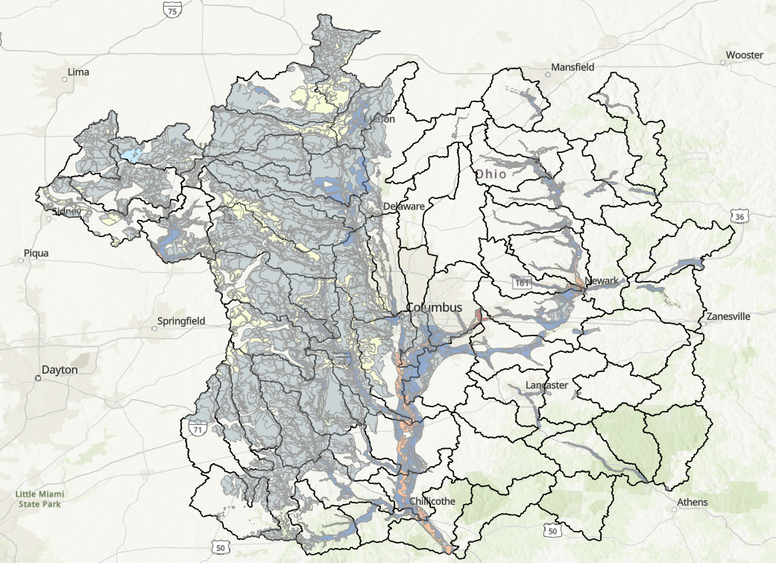
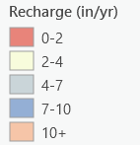
Ground Water Availability Approach
Ground water availability was estimated at the HUC 10 level
Eagon & Associates provided a high yield aquifer map
Ground water vulnerability and recharge maps were provided from ODNR data
Calculations used the average recharge value within high yield aquifers to derive a ground water availability value in MGD
After calculations, Eagon & Associates adjusted values as needed and reviewed values with ODNR

Slide 15
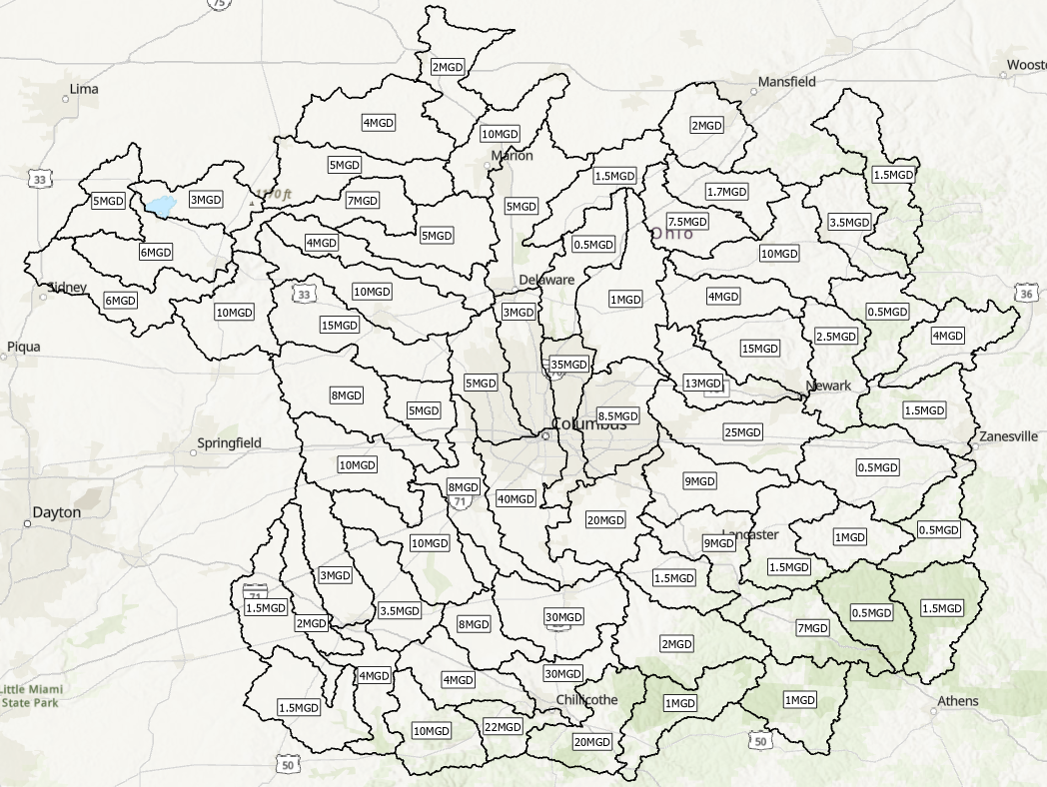
Ground Water Availability
The ground water availability values are meant to represent the availability for long-term, sustained daily use
Ground water availability values for each HUC 10 are shown in the figure to the right

Slide 16
Ground Water Availability
SCALE – This study estimates total ground water availability in each HUC-10 watershed as a single value, which makes its predictive capability only suitable for very large-scale assessments. The results are not suitable for site-specific analysis or any ground water investigations besides those at a regional or sub-regional scales.
DELINEATION - Aquifer boundaries do not always coincide with overlying surface water systems. In this study, ground water boundaries are defined by surface watersheds and, consequently, some aquifers may be split by unsuitable borders. This may lead to unexpected or misleading results, especially near watershed boundaries.
UNCERTAINTY - ground water maps and studies always involve a high degree of uncertainty due to the complex nature of aquifers and the lack of widespread, reliable datasets of aquifer characteristics and water-level information. While this is not unique to this study, its scale and timeframe make its ground water availability estimates especially uncertain. Site-specific ground water investigation could mitigate these uncertainties.

Slide 17
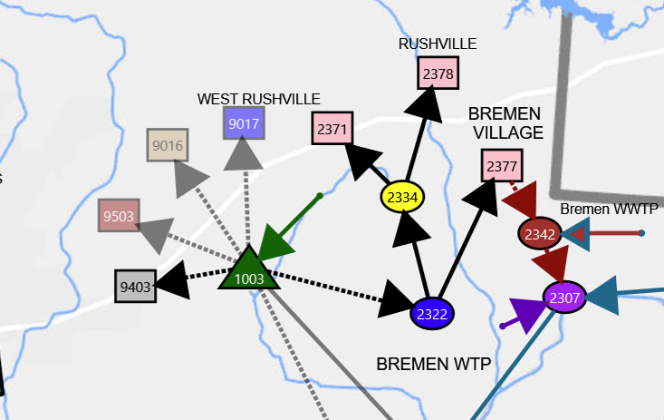
Incorporation of Ground Water Estimates in OASIS
In OASIS ground water is treated as a daily available water inflow, unused water is sent to a terminal node and storage is not accounted for since available ground water accounts for what is available in storage
When there is not enough ground water in the system to meet all demands, the water is proportionally delivered to each demand showing a shortage in each demand. I.e. does not prioritize one user over another
Ground water availability estimates remained constant for every scenario and did not change for future land use or climate scenarios
Example GW node to multiple demands

Slide 18
Surface Water Supplies and Reservoirs

Slide 19

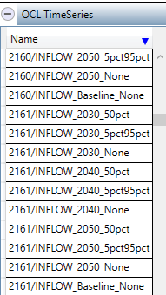
Surface Water Inflows
Surface water runoff volumes were added at points of interest into the OASIS model as inflows
  Areas of interest were identified as areas along streams with a surface water intake, instream reservoir or confluences with wastewater returns
Different inflows were provided as XML files for each watershed for various modeling scenarios
  OCL code was written to determine which timeseries to use for the simulation depending on user input within the OASIS platform.
Metrological data from SWMM was utilized to calculate precipitation and evaporation time series for Reservoirs
See SWMM Modeling Approach for more details on surface water runoff calculations
Modeled Inflows
10 inflow timeseries per surface water nodes representing different climate and year scenarios

Slide 20
Reservoirs

Slide 21
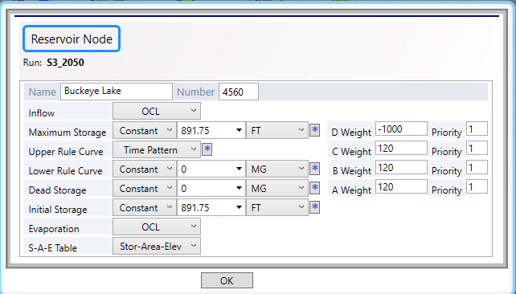
Reservoir Table in OASIS
For each reservoir, the information in the reservoir table was found from the following sources:
Inflows & Evaporation
  Derived from SWMM model
Maximum Storage
  Identified from ODNR GIS Dam layer
  Model discourages storing water here. Used for flood storage.
Upper Rule Curve- Normal/Summer Pool
  Identified for each reservoir as summer and normal pool
  If not strictly identified used the elevation of the dam crest
Lower Rule – Trigger for operations
  Only used for O'Shaughnessy and Griggs reservoirs.
  From Columbus OASIS model
Dead & Initial Storage
  Assumed 0 or the elevation of usable storage
Storage-Area-Elevation (SAE) Table
  Derived from ODNR contours in GIS
  If contours unavailable, assumed constant slope and used DEM data

Slide 22
Columbus Reservoir Operations
Operations developed with City for development of Columbus OASIS model of Drought Planning
Columbus Upground Reservoirs (Doutt, R1 and R3)
  Doutt Online through all scenarios
  R1 and R3 online starting in 2040
  Release water to O’Shaughnessy once usable storage of O’Shaughnessy < 80%
  Release is limited based on number of reservoirs online:
    Just Doutt: Maximum of 37 MGD
    Doutt, R1 and R3: Maximum of 70 MGD
O’Shaughnessy Reservoir
  Supplements Griggs Reservoir to keep Griggs usable storage at 95%
  Del-Co max allocation of 16.9 MGD to Olentangy Upground Reservoirs
  Starting in 2030, Home Rd WTP pulls directly from O’Shaughnessy Reservoir
Griggs Reservoir
  Releases water to downstream pump station for Dublin Rd WTP
  Begins drawdown once O’Shaughnessy usable storage is below 80%, Griggs and O’Shaughnessy are drawn down at the same rate

Slide 23
Alum Creek Allocations
Westerville: 3 MGD
  Westerville has two other water sources, ground water and Westerville Reservoir
  Historical data supports that Westerville will meet 90% of demand with surface water. 25% of that surface water demand is met with Westerville Reservoir
  Previous models and historical data show that Westerville does not always use their full 3 MGD allocation
Del-Co: 6 MGD
  Derived from communication with Del-Co
  Model prioritizes using Alum Creek allocation first to meet demand at RES WTP
  Del-Co also has access to downstream pumping station to fill TFM reservoir that is not part of their allocation
Columbus: 31 MGD yearly average (11.3 BG yearly allocation)
  Rules developed from Columbus OASIS model and collaboration with the City
  Pumping triggered when Hoover Reservoir reaches 75% capacity
    May to September – 35 MGD
    September to April – 70 MGD
  Pumping ceases when annual allotment is reached, or Hoover reaches seasonal capacity target:
    June to July - 90% capacity
    August to May – 80% capacity

Slide 24
Reservoir Surface Area Elevation (SAE) Curves and Operations

Slide 25
2160- Delaware Lake
Elevation (ft) | Storage (MG) | Area (acres)
885.15 | 0.00 | 0.02
887.34 | 0.08 | 0.23
889.53 | 0.49 | 1.57
891.72 | 6.03 | 16.72
893.91 | 25.01 | 48.33
896.10 | 88.57 | 112.29
898.29 | 195.66 | 194.92
900.48 | 363.72 | 275.75
902.67 | 580.41 | 338.12
904.86 | 856.99 | 424.80
907.05 | 1198.25 | 546.49
909.24 | 1642.66 | 712.37
911.43 | 2222.37 | 937.74
913.62 | 2995.61 | 1161.37
915.81 | 3849.87 | 1242.51
918.00 | 4781.73 | 1361.53
Maximum storage: constant = 947 ft
Upper Rule Curve: time pattern
Lower Rule Curve: constant = 0
Dead Storage: constant = 0
Nodes with Direct Withdrawals: 9303
Minimum Release: 5 cfs
Date | Elevation (ft)
11/30 | 915.00
12/01 | 910.00
01/01 | 910.00
04/14 | 910.00
04/15 | 915.00

Slide 26
2162- Westerville Reservoir
Elevation (ft) | Storage (acre-ft) | Area (acres)
826.00 | 0.00 | 0.00
873.00 | 1258.00 | 55.83
Maximum storage: constant = 873 ft
Upper Rule Curve: constant = 870 ft
Lower Rule Curve: constant = 0
Dead Storage: constant = 0
Nodes with Direct Withdrawals: 2533

Slide 27
2163- Alum Creek Lake
Elevation (ft) | Storage (MG) | Area (acres)
826.62 | 0.00 | 0.02
830.92 | 17.81 | 28.92
835.21 | 116.37 | 135.54
839.50 | 405.18 | 303.98
843.79 | 938.42 | 486.41
848.08 | 1735.98 | 679.86
852.37 | 2817.73 | 855.08
856.67 | 4224.73 | 1133.10
860.96 | 6004.63 | 1395.25
865.25 | 8155.40 | 1681.58
869.54 | 10675.49 | 1925.75
873.83 | 13520.42 | 2166.71
878.12 | 16708.77 | 2431.36
882.42 | 20322.83 | 2728.81
886.71 | 24302.94 | 3278.79
891.00 | 29161.90 | 3663.55
Maximum storage: constant = 901 ft
Upper Rule Curve: time pattern
Lower Rule Curve: constant = 841.5 ft
Dead Storage: constant = 841.5 ft
Nodes with Direct Withdrawals: 2122 & 2164
Minimum Release: 6.5 cfs
Date | Elevation (ft)
11/30 | 888.00
12/01 | 885.00
01/01 | 885.00
04/14 | 885.00
04/15 | 888.00

Slide 28
2164- Hoover Reservoir
Elevation (ft) | Storage (MG) | Area (acres)
831.50 | 17.90 | 20.50
835.00 | 65.70 | 74.90
844.00 | 504.60 | 242.60
854.00 | 1648.20 | 489.50
862.00 | 3209.90 | 726.80
870.00 | 5430.80 | 1000.20
872.00 | 6124.10 | 1137.60
874.00 | 6931.40 | 1340.50
875.00 | 7382.90 | 1428.50
879.00 | 9467.20 | 1773.60
880.00 | 10069.00 | 1900.20
882.00 | 11374.00 | 2088.40
884.00 | 12795.00 | 2264.10
889.00 | 16857.00 | 2722.20
890.00 | 17758.00 | 2802.20
896.00 | 23654.00 | 3234.80
902.00 | 30529.00 | 3796.10
904.00 | 33057.00 | 3942.90
Maximum storage: constant = 33056.6 MG
Upper Rule Curve: constant = 21591.9 MG
Lower Rule Curve: constant = 278.2 MG
Dead Storage: constant = 278.2 MG
Nodes with Direct Withdrawals: none

Slide 29
2167- Olentangy Upground Reservoirs
Elevation (ft) | Storage (MG) | Area (acres)
876.00 | 0.00 | 0.00
960.00 | 1564.00 | 171.60
Maximum storage: constant = 1564 MG
Upper Rule Curve: constant = 1562 MG
Lower Rule Curve: constant = 0
Dead Storage: constant = 0
Nodes with Direct Withdrawals: 2121
Pump Capacities:
  From 2108: 39.0 MGD
  From 2161: 16.2 MGD

Slide 30
2168- TFM Reservoirs
Elevation (ft) | Storage (MG) | Area (acres)
939.00 | 0.00 | 0.00
975.00 | 989.00 | 113.62
Maximum storage: constant = 991 MG
Upper Rule Curve: constant = 989 MG
Lower Rule Curve: constant = 0
Dead Storage: constant = 0
Nodes with Direct Withdrawals: 2122 & 2125
Pump capacity: 8.6 MGD

Slide 31
2166- Doutt Reservoir
Elevation (ft) | Storage (MG) | Area (acres)
920.00 | 0.00 | 0.00
925.00 | 1300.00 | 120.00
939.00 | 4830.00 | 445.00
955.00 | 9300.00 | 857.00
960.00 | 10530.00 | 970.00
Maximum storage: constant = 10530 MG
Upper Rule Curve: constant = 9300 MG
Lower Rule Curve: constant = 1300 MG
Dead Storage: constant = 1300 MG
Nodes with Direct Withdrawals: none

Slide 32
2560- Griggs Reservoir
Elevation (ft) | Storage (MG) | Area (acres)
734.00 | 0.00 | 0.40
738.00 | 22.10 | 52.30
739.00 | 42.90 | 75.40
741.00 | 105.70 | 116.90
744.00 | 245.50 | 170.80
746.00 | 375.20 | 228.20
747.00 | 453.40 | 252.30
750.00 | 727.70 | 310.30
752.00 | 937.30 | 338.60
757.00 | 1517.90 | 373.90
758.00 | 1643.00 | 389.30
Maximum storage: constant = 1643 MG
Upper Rule Curve: constant = 1419.8 MG
Lower Rule Curve: constant = 1348.81 MG
Dead Storage: constant = 1 MG
Nodes with Direct Withdrawals: none
Minimum Release: 41.3 cfs

Slide 33
2161- O'Shaughnessy Reservoir
Elevation (ft) | Storage (MG) | Area (acres)
799 | 0.00 | 0.00
805 | 13.30 | 18.60
808 | 39.10 | 36.40
812 | 102.50 | 63.70
815 | 176.10 | 87.40
825 | 606.60 | 191.30
830 | 984.00 | 276.00
836 | 1636.80 | 397.50
838 | 1915.20 | 461.30
840 | 2246.90 | 559.20
842 | 2652.50 | 690.70
843 | 2887.60 | 754.50
844 | 3142.40 | 803.10
846 | 3687.20 | 869.90
847 | 3975.10 | 896.80
848 | 4275.20 | 941.90
848.5 | 4429.9 | 954.9
849 | 4586.5 | 967.6
850 | 4907.3 | 1004.3
Maximum storage: constant = 4907.3 MG
Upper Rule Curve: constant = 4429.9 MG
Lower Rule Curve: constant = 3100.93 MG
Dead Storage: constant = 92.7 MG
Nodes with Direct Withdrawals: 2167
Minimum Release: 95.2 cfs

Slide 34
3760- Hocking Hills Reservoir
Elevation (ft) | Storage (MG) | Area (acres)
870.63 | 0.00 | 0.02
873.83 | 0.12 | 0.21
877.03 | 0.58 | 0.67
880.23 | 1.73 | 1.55
883.43 | 3.88 | 2.83
886.63 | 7.71 | 4.43
889.83 | 13.12 | 5.92
893.03 | 20.24 | 7.68
896.23 | 29.04 | 9.21
899.42 | 39.32 | 10.58
902.62 | 51.20 | 12.19
905.82 | 64.86 | 13.95
909.02 | 80.45 | 16.07
912.22 | 97.93 | 17.42
915.42 | 116.64 | 18.51
918.62 | 137.41 | 21.26
Maximum storage: constant = 906.83 ft
Upper Rule Curve: constant = 895 ft
Lower Rule Curve: constant = 0
Dead Storage: constant = 0
Nodes with Direct Withdrawals: none

Slide 35
2460- Washington Court House New Reservoir
Elevation (ft) | Storage (MG) | Area (acres)
962.90 | 0.00 | 0.00
984.00 | 803.00 | 37.85
Maximum storage: constant = 984 ft
Upper Rule Curve: constant = 981.13 ft
Lower Rule Curve: constant = 0
Dead Storage: constant = 0
Nodes with Direct Withdrawals: 2422

Slide 36
2461- Washington Court House Old Reservoir
Elevation (ft) | Storage (MG) | Area (acres)
981.00 | 0.00 | 0.00
1000.00 | 626.30 | 35.60
Maximum storage: constant = 1000 ft
Upper Rule Curve: constant = 998 ft
Lower Rule Curve: constant = 0
Dead Storage: constant = 0
Nodes with Direct Withdrawals: 2422
Pump Capacity: 6.0 MGD

Slide 37
3761- Lake Logan
Elevation (ft) | Storage (MG) | Area (acres)
739.04 | 0.00 | 0.02
740.51 | 1.38 | 6.30
741.97 | 6.99 | 16.49
743.43 | 16.90 | 25.26
744.90 | 36.50 | 59.62
746.36 | 71.21 | 83.75
747.82 | 116.21 | 104.88
749.29 | 169.99 | 120.60
750.75 | 232.22 | 143.85
752.22 | 308.05 | 175.26
753.68 | 399.42 | 204.74
755.14 | 500.65 | 219.37
756.61 | 609.00 | 231.43
758.07 | 738.36 | 317.20
759.54 | 895.29 | 341.08
761.00 | 1064.20 | 366.38
Maximum storage: constant = 782 ft
Upper Rule Curve: time pattern
Lower Rule Curve: constant = 0
Dead Storage: constant = 0
Nodes with Direct Withdrawals: none
Date | Elevation (ft)
01/01 | 759.00

Slide 38
4260- Apple Valley Lake
Elevation (ft) | Storage (MG) | Area (acres)
937.31 | 0.00 | 0.02
941.51 | 4.40 | 10.72
945.70 | 27.61 | 23.04
949.90 | 67.01 | 35.27
954.09 | 130.74 | 57.73
958.29 | 225.70 | 80.94
962.49 | 361.00 | 114.91
966.68 | 535.51 | 141.08
970.88 | 755.58 | 185.21
975.07 | 1042.95 | 232.71
979.27 | 1388.45 | 271.77
983.47 | 1784.02 | 304.52
987.66 | 2219.17 | 331.72
991.86 | 2691.41 | 359.63
996.05 | 3209.89 | 402.89
1000.25 | 3810.62 | 471.37
Maximum storage: constant = 1028 ft
Upper Rule Curve: constant = 1026 ft
Lower Rule Curve: constant = 0
Dead Storage: constant = 0
Nodes with Direct Withdrawals: none

Slide 39
4560- Buckeye Lake
Elevation (ft) | Storage (MG) | Area (acres)
876.79 | 0.00 | 0.02
877.86 | 0.61 | 4.24
878.92 | 3.10 | 10.35
879.99 | 8.63 | 26.27
881.05 | 24.05 | 61.44
882.11 | 52.21 | 108.42
883.18 | 110.33 | 244.44
884.24 | 240.35 | 531.57
885.30 | 477.35 | 854.96
886.37 | 849.78 | 1299.29
887.43 | 1395.43 | 1866.83
888.50 | 2129.23 | 2287.48
889.56 | 3001.26 | 2843.93
890.62 | 4049.75 | 3107.77
891.69 | 5144.30 | 3207.25
892.75 | 6276.98 | 3336.77
Maximum storage: constant = 891.75 ft
Upper Rule Curve: time pattern
Lower Rule Curve: constant = 0
Dead Storage: constant = 0
Nodes with Direct Withdrawals: none
Date | Elevation (ft)
01/01 | 889.00
03/01 | 890.00
03/15 | 890.50
04/01 | 891.00
05/01 | 891.75
11/01 | 891.78
11/15 | 891.00
12/01 | 890.00
12/15 | 889.00

Slide 40
4561- Dillion Lake
Elevation (ft) | Storage (MG) | Area (acres)
711.59 | 0.00 | 0.02
713.49 | 0.38 | 2.04
715.38 | 3.34 | 8.88
717.27 | 16.95 | 37.33
719.17 | 57.27 | 131.57
721.06 | 170.30 | 221.38
722.96 | 330.19 | 306.70
724.85 | 547.06 | 393.14
726.74 | 835.89 | 515.94
728.64 | 1183.47 | 624.51
730.53 | 1599.53 | 714.57
732.42 | 2075.61 | 811.64
734.32 | 2599.85 | 910.27
736.21 | 3228.88 | 1136.83
738.11 | 3989.62 | 1341.77
740.00 | 4874.27 | 1499.75
Maximum storage: constant = 790 ft
Upper Rule Curve: time pattern
Lower Rule Curve: constant = 0
Dead Storage: constant = 0
Nodes with Direct Withdrawals: none
Minimum Release: 50 cfs
Date | Storage (ft)
11/30 | 737.00
12/01 | 734.00
01/01 | 734.00
04/14 | 734.00
04/15 | 737.00

Slide 41
4660- Indian Lake
Elevation (ft) | Storage (MG) | Area (acres)
979.26 | 0.00 | 0.02
980.20 | 0.99 | 7.76
981.14 | 5.12 | 19.77
982.09 | 13.32 | 32.63
983.03 | 25.01 | 43.10
983.97 | 40.07 | 57.85
984.91 | 64.05 | 99.00
985.86 | 105.69 | 193.24
986.80 | 288.73 | 1190.41
987.74 | 771.90 | 2014.79
988.69 | 1608.34 | 3493.22
989.63 | 2758.15 | 3944.89
990.57 | 4040.51 | 4460.15
991.52 | 5462.48 | 4747.49
992.46 | 7018.32 | 5323.71
993.40 | 8671.11 | 5418.18
Maximum storage: constant = 998.3 ft
Upper Rule Curve: constant = 996.3
Lower Rule Curve: constant = 0
Dead Storage: constant = 0
Nodes with Direct Withdrawals: none

Slide 42
4960- Choctaw Lake
Elevation (ft) | Storage (acre-ft) | Area (acres)
998.00 | 0.00 | 0.00
1040.00 | 7783.00 | 563.26
Maximum storage: constant = 7783 acre-ft
Upper Rule Curve: constant = 1016.4 ft
Lower Rule Curve: constant = 0
Dead Storage: constant = 0
Nodes with Direct Withdrawals: none

Slide 43
6460- Somerset Reservoir
Elevation (ft) | Storage (acre-ft) | Area (acres)
909.90 | 0.00 | 0.00
945.00 | 130.40 | 9.52
Maximum storage: constant = 945 ft
Upper Rule Curve: constant = 941.2 ft
Lower Rule Curve: constant = 0
Dead Storage: constant = 0
Nodes with Direct Withdrawals: 6421

Slide 44
6461- New Lexington Reservoir
Elevation (ft) | Storage (acre-ft) | Area (acres)
864.00 | 0.00 | 0.00
909.00 | 707.00 | 36.00
Maximum storage: constant = 909 ft
Upper Rule Curve: constant = 907.75 ft
Lower Rule Curve: constant = 0
Dead Storage: constant = 0
Nodes with Direct Withdrawals: 6420

Slide 45
6462- New Lexington Water Supply Reservoir
Elevation (ft) | Storage (acre-ft) | Area (acres)
895.50 | 0.00 | 0.00
940.00 | 1144.00 | 44.00
Maximum storage: constant = 940 ft
Upper Rule Curve: constant = 938 ft
Lower Rule Curve: constant = 0
Dead Storage: constant = 0
Nodes with Direct Withdrawals: 6420

Slide 46
6560- Deer Creek Lake
Elevation (ft) | Storage (MG) | Area (acres)
773.37 | 0.00 | 0.02
776.04 | 0.36 | 0.88
778.72 | 1.63 | 2.12
781.39 | 9.87 | 31.04
784.07 | 65.72 | 106.03
786.74 | 217.39 | 231.01
789.42 | 452.06 | 308.17
792.10 | 807.66 | 503.49
794.77 | 1282.99 | 580.69
797.45 | 1864.81 | 752.47
800.12 | 2592.32 | 910.06
802.80 | 3447.96 | 1031.54
805.47 | 4386.01 | 1127.98
808.15 | 5448.38 | 1310.08
810.82 | 6613.59 | 1365.12
813.50 | 7850.88 | 1475.94
Maximum storage: constant = 844 ft
Upper Rule Curve: time pattern
Lower Rule Curve: constant = 0
Dead Storage: constant = 0
Nodes with Direct Withdrawals: none
Minimum Release: 10 cfs
Date | Elevation (ft)
11/30 | 810.00
12/01 | 796.00
01/01 | 796.00
04/14 | 796.00
04/15 | 810.00

Slide 47
7160- Paint Creek Lake
Elevation (ft) | Storage (MG) | Area (acres)
757.98 | 0.00 | 0.04
760.78 | 0.49 | 1.64
763.58 | 5.99 | 13.41
766.38 | 24.96 | 30.64
769.18 | 80.90 | 100.70
771.98 | 202.72 | 159.21
774.79 | 381.96 | 232.50
777.59 | 617.88 | 288.36
780.39 | 926.33 | 383.17
783.19 | 1308.06 | 459.11
785.99 | 1783.05 | 655.50
788.79 | 2467.31 | 878.00
791.60 | 3351.45 | 1051.41
794.40 | 4400.45 | 1203.90
797.20 | 5516.28 | 1239.89
800.00 | 6670.49 | 1302.04
Maximum storage: constant = 845 ft
Upper Rule Curve: time pattern
Lower Rule Curve: constant = 0
Dead Storage: constant = 0
Nodes with Direct Withdrawals: none
Minimum Release: 10 cfs
Date | Elevation (ft)
11/30 | 798.00
12/01 | 787.50
01/01 | 787.50
04/14 | 787.50
04/15 | 798.00

Slide 48
8060- Marysville Reservoir
Elevation (ft) | Storage (MG) | Area (acres)
973.00 | 0.00 | 0.00
1021.00 | 1510.00 | 171.00
Maximum storage: constant = 1021 ft
Upper Rule Curve: constant = 1021 ft
Lower Rule Curve: constant = 0
Dead Storage: constant = 0
Nodes with Direct Withdrawals: 8020
Pumping Capacity: 2.00 MGD

Slide 49
Water Treatment Plants

Slide 50
Data Used
OASIS model includes all water treatment plants (WTPs) with associated permitted treatment capacities and connections to demands
The following data were used for water treatment plant characterization
  Historical Water Treatment Plant Production Data – Used to calculate average daily demand, monthly peaking factors, and to validate OASIS flows
  Master Plans – Used for utility specific information, as available
  Municipality Consumer Confidence Reports - Used to confirm operations and water supply sources
  Home - Drinking Water Viewer – Used to identify emergency connections or water purchases between plants
  ODNR Surface Water / ground water Withdraw Capacities – used to identify water supply withdraw limits

Slide 51
WTP Capacities in Model

Slide 52
WTP Capacities (Base Year)
OASIS NUMBER | PLANT NAME | Capacity (MGD)
2120 | DELAWARE WTP | 8.04
2121 | DEL-CO OLENTANGY WTP | 28.8
2122 | RE SCOTT WTP (ALUM CK) | 6.55
2123 | THOMAS E. STEWARD WTF | 6
2125 | TFM WTP | 4
2320 | AMANDA VILLAGE WTP | 0.288
2321 | BALTIMORE WTP | 0.72
2322 | BREMEN VILLAGE OF | 0.432
2323 | FAIRFIELD COUNTY WTP | 3
2324 | GREENFIELD TWP WATER DISTRICT | 0.576
2325 | LANCASTER CITY - NORTH PLANT | 9.3
2326 | LANCASTER CITY - SOUTH PLANT | 8.4
2328 | LITTLE WALNUT WTP | 0.5
2329 | MILLERSPORT VILLAGE | 1
2330 | PICKERINGTON WTP | 3.5
2331 | PLEASANTVILLE PWS | 0.1224
2332 | SUGAR GROVE VILLAGE WTP | 0.1224
2333 | THURSTON WTP 2 | 0.144
2352 | LITHOPOLIS PWS | 0.5
OASIS NUMBER | PLANT NAME | Capacity (MGD)
2420 | BLOOMINGBURG PWS | 0.25
2421 | JEFFERSONVILLE PWS | 0.3744
2422 | WASHINGTON COURT HOUSE PWS | 3
2423 | I-71 & ST RTE 35 PWS | 0.2016
2520 | AQUA OHIO - BLACKLICK | 1.44
2521 | AQUA OHIO - HUBER RIDGE | 1.15
2522 | AQUA OHIO - LAKE DARBY | 0.72
2523 | AQUA OHIO - WORTHINGTON HILLS | 0.72
2524 | CANAL WINCHESTER WTP | 2
2525 | CITY OF GROVEPORT WTP 2 | 0.576
2526 | COLUMBUS DUBLIN ROAD WTP | 80
2527 | COLUMBUS HAP CREMEAN WTP | 125
2528 | COLUMBUS PARSONS AVE WTP | 50
2529 | JWSD WTP | 1.73
2530 | AQUA OHIO - TIMBERBROOK | 0.18
2531 | TIMBERLAKE WATER SYSTEM | 0.3
2532 | OBETZ PWS | 0.432
2533 | WESTERVILLE WTP | 7.5
OASIS NUMBER | PLANT NAME | Capacity (MGD)
3720 | LAURELVILLE VILLAGE | 0.4248
3721 | LOGAN WTP | 2.5
4220 | DANVILLE STU 2 | 0.3
4221 | FREDERICKTOWN WTP | 0.67
4222 | KNOX CO W & WW | 1.152
4223 | MARTINSBURG VILLAGE | 0.0432
4224 | MOUNT VERNON WTP | 6.2
4520 | GRANVILLE WTP | 2
4521 | HEATH CITY | 4
4522 | HEBRON VILLAGE | 2.16
4523 | JOHNSTOWN WTP | 1
4524 | NEWARK WTP | 15
4525 | LICKING CO PRESCOTT ESTATES | 0.17
4526 | PATASKALA WTF STU 1 | 1.3
4527 | PATASKALA WTF STU 2 | 0.864
4528 | ST. LOUISVILLE WTP | 0.108
4529 | SWLCW STU 2 | 3
4530 | UTICA WATER DEPT | 0.72

Slide 53
WTP Capacities (Base Year) Continued
OASIS NUMBER | PLANT NAME | Capacity (MGD)
4620 | BELLE CENTER VILLAGE | 0.489
4621 | BELLEFONTAINE CITY STU 2 WEST | 4.61
4622 | DEGRAFF VILLAGE | 0.24
4623 | LAKEVIEW WATER DEPARTMENT | 0.374
4624 | RUSSELLS POINT WTP | 0.43
4625 | QUINCY VILLAGE | 0.576
4626 | RUSHSYLVANIA PWS | 0.24
4627 | WEST LIBERTY WTP | 0.43
4628 | WEST MANSFIELD PWS | 0.14
4920 | CHOCTAW UTILITIES STU2 | 0.55
4921 | LONDON WTP | 1.5
4922 | WATER DISTRICT 1 TREATMENT PLANT | 1.5
4923 | MOUNT STERLING TREATMENT PLANT 2 | 0.864
4924 | PLAIN CITY PWS | 1.152
4925 | WEST JEFFERSON PWS | 0.936
OASIS NUMBER | PLANT NAME | Capacity (MGD)
4926 | SOUTH SOLON WTP | 0.1224
5120 | AQUA OHIO - MARION | 9.1
5121 | LA RUE VILLAGE | 0.18
5122 | OAKRIDGE ESTATES LLC | 0.0936
5920 | CARDINGTON WTP | 0.75
5921 | MT GILEAD WTP | 1
6420 | NEW LEXINGTON WTP | 1
6421 | WTP-SOMERSET | 0.425
6422 | WTP-THORNVILLE | 0.504
6423 | BURR OAK REGIONAL WTP | 4
6424 | ROSEVILLE WTP | 0.5
6520 | ASHVILLE VILLAGE | 0.65
6521 | CIRCLEVILLE CITY | 4
6522 | COMMERCIAL POINT - TP2 | 1
6523 | DARBYVILLE WTP | 0.085
OASIS NUMBER | PLANT NAME | Capacity (MGD)
6524 | EARNHART HILL REGIONAL W & SD | 2.16
6525 | NEW HOLLAND VILLAGE | 0.216
6526 | SOUTH BLOOMFIELD VILLAGE | 0.25
6527 | WILLIAMSPORT WTP | 0.216
6528 | PICKAWAY CORRECTIONAL INSTITUTION | 2.3
7120 | BAINBRIDGE VILLAGE | 0.432
7121 | CHILLICOTHE WTP | 7
7122 | ROSS CO WATER SOUTH PLANT | 4.57
7123 | ROSS CO WATER NORTH PLANT | 4
7124 | CLARKSBURG VILLAGE | 0.072
7125 | FRANKFORT VILLAGE | 0.3168
7126 | KINGSTON VILLAGE | 0.23
8020 | MARYSVILLE WTP 2 | 4
8021 | MILFORD CENTER WTP | 0.166
8022 | RICHWOOD WTP | 0.374

Slide 54
Assumed WTP Capacity Changes
Future plants and increased capacities were incorporated into the model for future model years. These assumed changes are as follows:
COUNTY | OASIS NUMBER | PLANT NAME (NODE) | BASECASE CAPACITY (MGD) | FUTURE CAPACITY (MGD) | YEAR FUTURE CAPACITY INCORPORATED
Licking | 4523 | Johnstown WTP | 1 | 3 | 2030
Licking | 4555 | Licking Regional WTP | 3 | 5 | 2030
Franklin | 2535 | Home Road WTP | N/A | 48 | 2030

Slide 55
WTP Operations and Withdrawals

Slide 56
Municipalities with Multiple WTP
For municipalities with multiple water treatment plants, hydraulic distribution areas were not accounted for in the model. Instead, the demand on each WTP was proportional to the individual treatment capacity over the entire system capacity. If one plant could not meet the demand based on supply availability, a connected plant was allowed to make up the deficit and deliver more water.
Systems with Multiple Plants
Municipality | Number of WTP's | Total System Capacity (MGD) | Plants
Ross County Water | 2 | 8.57 | Ross County Water North Plant, Ross County Water South Plant
City of Lancaster | 2 | 17.7 | Lancaster City- North Plant, Lancaster City - South Plant
Fairfield County Utilities | 3 | 4.076 | Fairfield County Tussing Rd WTP, Greenfield TWP, Little Walnut WTP
City of Pataskala | 2 | 2.164 | Pataskala WTF STU 1, Pataskala WTP STU 2
Del-Co | 4 | 45.35 | Olentangy WTP, Thomas E. Steward WTP, RE Scott WTP, Timothy McNamara WTP (Summer Only)
City of Columbus | 3 (Current), 4 (Future Years) | 255 (Current), 303 (Future) | Dublin Road WTP, Hap Cremean WTP, Parsons Ave WTP, Home Road WTP (Future)
Mid-Ohio | 3 | 4.152 | Water District 1 Treatment Plant, Plain City WTP, London WTP

Slide 57
WTP Rules for Plants with Multiple Sources
For water treatment plants with multiple water sources, municipal master plans, city websites and ODNR withdrawal data were utilized to determine the use between sources. If one source is in a deficit, the model still allowed access to the other source (if available) to meet demands even if did not match historical operations.
Municipality | Water Sources | Model Assumption
Washington Court House | Washington Court House Upground Reservoirs, ground water | CCR indicates meeting 40% of demand in summer with ground water
Westerville | Alum Creek Allocation, Westerville Reservoir, ground water | Production data indicates city meeting 10% of demands with ground water. Surface water demand is met using Alum Creek allocation first
Aqua Ohio Marion | Little Scioto River, ground water | Production data indicates demands being met with 40% ground water
Marysville | Marysville Reservoir, ground water | City indicated only using ground water during shortfalls in surface water availability.

Slide 58
WTP Surface Water Withdraw Capacities
COUNTY | OASIS NUMBER | PLANT NAME | Surface Water Withdrawal Capacity (MGD)
Delaware | 2120 | DELAWARE WTP | 8.04
Delaware | 2121 | DEL-CO OLENTANGY WTP | 5.76
Delaware | 2122 | RE SCOTT WTP (ALUM CK) | 6
Delaware | 2125 | TFM WTP | 4
Fayette | 2422 | WASHINGTON COURT HOUSE PWS | 6
Franklin | 2526 | COLUMBUS DUBLIN ROAD WTP | 130
Franklin | 2527 | COLUMBUS HAP CREMEAN WTP | 200
Franklin | 2533 | WESTERVILLE WTP | 3
Franklin | 2535 | COLUMBUS HOME RD WTP | 48
Licking | 4524 | NEWARK WTP | 15
Marion | 5120 | AQUA OHIO - MARION | 24.06
Perry | 6420 | NEW LEXINGTON WTP | 1
Perry | 6421 | WTP-SOMERSET | 0.62
Union | 8020 | MARYSVILLE WTP 2 | 2
Data from ODNR Withdrawal Capacities
Surface water capacities were modeled as constraints to follow permits from ODNR
  Pumping capacities are representative of the pumping capacity from the source tributary to either the WTP or a systems upground reservoir
Ground water withdrawals were NOT constrained as historical data indicated users withdrew more than ODNR permits regularly based on pumping capacity

Slide 59
Wastewater Treatment Plants

Slide 60
Data Used
OASIS model includes all wastewater treatment plants (WWTPs) with associated permitted treatment capacities and connections to demands
The following data were used for wastewater treatment plant characterization
  Historical WWTP Discharge Data – Used to validate WWTP flows in OASIS model
  Master Plans – Used for utility specific information, as available
  NPDES Information – Used to determine WWTP discharge location, WWTP plant capacity

Slide 61
WWTP Capacities, Returns and Assumptions

Slide 62
WWTP Flow Assumptions
Initially assumed that 90% of WTP production was returned to WWTP
Reviewed Base Flow, I&I Flow, and Total Flow and compared to Historical data to determine any correction factors that needed to be added for the estimation of WWTP flows (see I&I section)
Model only accounted for wastewater returns that discharge to surface water
  Septic returns are considered to be captured in the available ground water availability calculations
Created an approach for Inflow and Infiltration, which will be discussed further in subsequent slides
Model allows all projected wastewater flows to pass through a WWTP node regardless of WWTP capacity. Capacity is used as a flag in dashboard to identify gaps.
For systems with multiple WWTPs, wastewater flow to each plant was split proportionally based on WWTP capacity. Systems with multiple WWTP’s:
  City of Columbus
  Delaware Regional Sewer District
  Mid- Ohio (Starting in 2030)
  Lancaster
  Fairfield County Utilities
  Licking County Regional Water District
  Aqua Ohio Marion

Slide 63
WWTP Capacities (Base Year)
OASIS NUMBER | PLANT NAME | Capacity (MGD)
2140 | Alum Creek WWTP | 10
2141 | Ashley WWTP | 0.19
2142 | Galena WWTP No 2 | 0.5
2143 | Lower Scioto WRF | 1.4
2144 | Olentangy Environmental Control Center | 6
2145 | Ostrander WWTP | 0.09
2146 | Sunbury WWTP | 1.125
2147 | Upper Olentangy WRF | 10
2340 | Amanda WWTP | 0.1269
2341 | Baltimore WWTP | 1.01
2342 | Bremen WWTP | 0.336
2343 | Lancaster WPCF | 10
2344 | Little Walnut Sycamore WRF | 0.75
2345 | Millersport STP | 1
2346 | Pickerington WWTP | 3.2
2348 | Stoutsville WWTP | 1.3
2349 | Sugar Grove WWTP | 0.07
2350 | Upper Hocking WPCF | 2
2351 | Walnut Creek SD | 0.4
2353 | Tussing RD WRF | 3
OASIS NUMBER | PLANT NAME | Capacity (MGD)
2440 | Bloomingburg WWTP | 0.25
2441 | Jeffersonville WWTP No 2 | 0.1
2442 | Rattlesnake SD #1 WWTP | 1
2443 | Washington Court House WWTP | 6
2540 | Aqua Ohio - Blacklick WWTP | 1.2
2541 | Aqua Ohio - Huber Ridge WWTP | 1.03
2542 | Aqua Ohio - Lake Darby WWTP | 0.5
2544 | Canal Winchester WWTP | 2.48
2545 | Columbus Southerly WWTP | 114
2546 | Darbydale WWTP | 0.45
2547 | Jackson Pike WWTP | 68
3740 | Laurelville WWTP | 0.2
3741 | Logan WWTP | 1.6
3742 | Rockbridge WWTP | 0.028
4240 | Centerburg WRF | 0.2
4241 | Danville WWTP | 0.2
4242 | Fredericktown WWTP | 0.3
4243 | Gambier WWTP | 0.45
4244 | Little Jelloway Creek WWTP | 0.9
4245 | Mount Vernon WWTP | 3.5
OASIS NUMBER | PLANT NAME | Capacity (MGD)
4540 | Alexandria WWTP | 0.08
4541 | Buckeye Lake WWTP | 2
4542 | Granville WWTP | 2
4543 | Hanover WWTP | 0.16
4544 | Hartford WWTP | 0.06
4545 | Heath WWTP | 1.75
4546 | Hebron Village WRF | 2.16
4547 | Johnstown WWTP | 1.2
4548 | Kirkersville WWTP | 0.1
4549 | Newark WWTP | 8
4550 | Pataskala WWTP | 3
4551 | SWLCWSD Gale Rd Envir Control Facility | 4.3
4552 | Utica WWTP | 0.42
4640 | Bellefontaine WWTP | 4.5
4641 | Indian Lake WPCF | 4.6
4643 | Quincy-DeGraff STP | 0.495
4644 | Rushsylvania WWTP | 0.1
4645 | West Liberty STP | 0.5

Slide 64
WWTP Capacities (Base Year) Continued
OASIS NUMBER | PLANT NAME | Capacity (MGD)
4940 | London WWTP | 5.8
4941 | Madison County SD #2 WWTP | 0.3
4942 | Mount Sterling WWTP | 1
4943 | Plain City WWTP | 0.495
4944 | South Solon WWTP | 0.1
4945 | West Jefferson WWTP | 0.5
4946 | Madison County SD #1 | 0.15
5140 | Caledonia WWTP | 0.0759
5141 | Grandview Estates SD 2A | 0.2
5142 | LaRue WWTP | 0.6
5143 | Marion WPC | 10.5
5144 | New Bloomington WWTP | 0.125
5145 | Prospect WWTP | 0.24
5146 | SD No 7 Water Reclamation Plant | 1.75
5147 | Waldo WWTP | 1.4
5148 | Fountain Place WWTP SD 5A | 0.1
OASIS NUMBER | PLANT NAME | Capacity (MGD)
5940 | Cardington WWTP | 0.5
5941 | Chesterville WWTP | 0.095
5943 | Marengo Village | 0.038
5944 | Mt Gilead WWTP | 1
5945 | SoMoCo WWTP | 0.175
5946 | Sparta WWTP | 0.042
6440 | Corning WWTP | 0.06
6441 | Glenford WWTP | 0.036
6442 | Junction City WWTP | 0.1
6443 | New Lexington WWTP | 0.87
6444 | New Straitsville WWTP | 0.095
6445 | Shawnee WWTP | 0.093
6446 | Somerset WWTP | 0.25
6447 | Thornville WWTP | 0.4
6448 | Roseville WWTP | 0.671
6540 | Ashville Village WRRF | 0.8
OASIS NUMBER | PLANT NAME | Capacity (MGD)
6541 | Circleville WWTP | 4
6542 | Commercial Point WWTP | 0.43
6543 | New Holland WWTP | 0.15
6544 | Pickaway Correctional Institution | 2.3
6545 | South Bloomfield WWTP No 2 | 0.5
6546 | Williamsport WWTP | 0.15
6547 | Earnhart Hill Regional W & SD WWTP #2 | 0.3
7140 | Chillicothe WWTP - Easterly | 3.8
7141 | Clarksburg WWTP | 0.06
7142 | Frankfort WWTP | 0.19
7143 | Kingston WWTP | 0.052
7144 | South Salem WWTP | 0.03
7145 | Village of Bainbridge WWTP | 0.15
8040 | Liberty Twp Regional Treatment Facility | 0.1
8041 | Marysville WRF | 10
8042 | Richwood WWTP | 0.38

Slide 65
Assumed WWTP Capacity Changes
Future plants, decommissioned plants, and increased capacities were incorporated into the model for future model years. These assumed changes are as follows:
COUNTY | OASIS NUMBER | PLANT NAME (NODE) | BASECASE CAPACITY (MGD) | FUTURE CAPACITY (MGD) | YEAR FUTURE CAPACITY INCORPORATED
Licking | 4523 | Johnstown | 1.2 | 2.4 | 2030
Madison | 4948 | Mid-Ohio | 0 | 5 | 2030
Pickaway | 6542 | Commercial Point | 0.43 | 1.4 | 2030
Licking | 4553 | Wagram | 0 | 2.5 | 2030
Licking | 4550 | Pataskala | 1.1 | 3 | 2030
Logan | 4642 | Logan County ERSD WWTP | 0 | 0.1 | 2030
COUNTY | OASIS NUMBER | PLANT NAME (NODE) | BASECASE CAPACITY (MGD) | FUTURE CAPACITY (MGD) | YEAR OF DECOMISSIONING
Madison | 4946 | Madison County SSD 1 | 0.15 | 0 | 2030
Madison | 4941 | Madison County SSD 2 | 0.3 | 0 | 2030

Slide 66
Inflow & Infiltration (I&I) Application

Slide 67
I&I Methodology
Used City of Columbus collection system model to approximate the amount of rainfall that becomes I&I for combined and sanitary service areas
I&I flows to individual WWTPs are based on service area size, service area characteristics (combined vs. separate), and historical rainfall
  Used 2A forms from NPDES permits to determine the percent of every WWTP service area in the 15-county model that is combined versus separate
To maintain mass-balance, I&I inflows were removed from closest downstream surface water inflow to account for water from watershed captured through wastewater treatment plant
Reviewed model outputs, compared to historical data, and adjusted assumptions as needed

Slide 68
I&I Rainfall Assumptions
WWTP w/ Service Areas < 15,000 acres |  |  |  | WWTP w/ Service Areas > 15,000 acres
Daily rain depth, inches | Combined Systems |  | Separate Systems | Summed rain depth (past 3 days and current day), inches | Combined Systems |  | Separate Systems
 | % of daily rain volume over combined system area that contributes to I&I | % of daily rain volume over separate area that contributes to I&I | % of rain over total area that contributes to I&I |  | % of 4-day summed rain volume over combined system area that contributes to I&I | % of 4-day summed rain volume over separate system area that contributes to I&I | % of 4-day summed rain volume over total area that contributes to I&I
0-0.15 | 50% | 4% | 4% | 0-0.15 | 50% | 4% | 4%
0.15-0.5 | 40% | 2% | 4% | 0.15-0.5 | 40% | 2% | 2%
0.5-1.0 | 40% | 2% | 2% | 0.5-1.0 | 40% | 2% | 2%
>1.0 | 1.5% | 0.5% | 0.5% | >1.0 | 1.5% | 0.5% | 0.5%

Slide 69
Drinking Water Demands

Slide 70
Water Demand Categorization
Demands calculated per modeling scenario based on future population projections
Data: Per capita calculated with OEPA Production data (average daily production 2022-2023) and 2021 base population in service areas
Municipal
Individual Demand Node for each
Community
Apply municipality specific seasonal peaking factor
Non-Municipal
Public
Public Non-Municipal
Data: Determine daily water use from either OEPA production data, ODNR annual withdrawals or OEPA SWAPPs
Data: PWSID List from OEPA
Transient
Residential Demand Node
Non-Community
For each defined* Surface water source
Non-Transient
Surface Water
Industrial Demand Node
Combine Public-non municipal with large private withdrawals
Determine Source water type for each user
Apply demand specific seasonal peaking factor
Commercial
Demand Node
> 100,000 GPD
Private
Data: ODNR registered withdrawals
Agricultural
Demand Node
For each different HUC 10 Aquifer
< 100,000 GPD
No permit- assume private wells
Ground water
Seasonal
Demand Node
Data: GIS analysis of non-serviced parcels. Assumed per capita water use 70 GPD.

Slide 71
Municipal Demands

Slide 72
Municipal Demands
Data Used
  MORPC/ODOD Population Projections
  Service Areas (Derived from Available Maps/Shapefiles, Municipal Boundaries, or USEPA Water Service Area Layer)
    Community Water System Service Area Boundaries | US EPA
  2022-2023 Production Data (derived current annual average demand to calculate peaking factors and per-capita water use)
Future demands were calculated with the following method:
  Average Historical per Capita Water Use = Average 2022-2023 Water Production / Base Year Population in Service Area
  𝑴𝒖𝒏𝒊𝒄𝒊𝒑𝒂𝒍 𝑫𝒆𝒎𝒂𝒏𝒅𝒔 (𝑴𝑮𝑫) = 𝑨𝒗𝒆𝒓𝒂𝒈𝒆 𝑯𝒊𝒔𝒕𝒐𝒓𝒊𝒄𝒂𝒍 𝑷𝒆𝒓 𝑪𝒂𝒑𝒊𝒕𝒂 𝑾𝒂𝒕𝒆𝒓 𝑼𝒔𝒆 ∗ 𝑷𝒓𝒐𝒋𝒆𝒄𝒕𝒆𝒅 𝑷𝒐𝒑𝒖𝒍𝒂𝒕𝒊𝒐𝒏 𝒊𝒏 𝑺𝒆𝒓𝒗𝒊𝒄𝒆 𝑨𝒓𝒆𝒂 (𝑶𝑫𝑶𝑫 𝒐𝒓 𝑴𝑶𝑹𝑷𝑪) ∗ 𝑪𝒂𝒍𝒄𝒖𝒍𝒂𝒕𝒆𝒅 𝑺𝒆𝒂𝒔𝒐𝒏𝒂𝒍 𝑷𝒆𝒂𝒌𝒊𝒏𝒈 𝑭𝒂𝒄𝒕𝒐𝒓

Slide 73
Non-Municipal Demands

Slide 74
Non-Municipal Demands
Data Used:
  OEPA Source Water Protection Plans
  ODNR Withdraw Data
  Data was aggregated into singular nodes by source as reflected in the demand flow chart
    Seasonal demands include Golf Courses and Campgrounds or other users with only summer use
    Residential demands include mobile home parks and apartment complexes on their own wells
    Agriculture demands includes farms and orchards with heavier water use in the dry season
    Commercial demands include all users who have daily water use for potable water
    Industrial demands includes those users classified as industry by ODNR or Mineral Extraction. Different peaking factors were applied for regular industrial users, future large industrial users and quarry industrial users.
Peaking factors were developed for each demand type by analyzing a representative sample of demand data for each category
Assumed no growth for current non-municipal demands

Slide 75
Non-Municipal Demand Peaking Factors
Applied to projected water demands from existing industrial users based on historical water use
Applied to projected water demands from new industrial users based on stakeholder input and industrial cooling trends

Slide 76
Quarry Demands

Slide 77
Industrial – Quarry Demands
Quarry demands are met only after all other system demands have been met. They have unique peaking factors compared to all other demands in the OASIS model. Quarry demands are for dewatering the quarry after encountering the water table. Quarry demands were calculated using reported withdrawals for the past 5 years.
COUNTY | OASIS NUMBER | DEMAND NAME | DEMAND (MGD)
Licking | 9113 | Van Wey Sand & Gravel | 0.09
Logan | 9143 | Shelly Materials – Belle Center | 0.63
Pickaway | 9206 | Melvin Stone Company- Williamsport Quarry | 0.67
Ross | 9219 | S&S Aggregate - Chillocothe | 0.15
Ross | 9223 | Melvin Stone – Plano | 5.76
Franklin | 9246 | The Olen Corporation | 22.72
Franklin | 9247 | Columbus Limestone | 11.08
Union | 9248 | Shelly Materials - Ostrander | 4..74
Franklin | 9249 | Dewatering - AGG ROK Materials | 2.14
Marion | 9250 | National Lime & Stone - Marion | 2.10
Delaware | 9251 | National Lime & Stone - Delaware | 3.551
Franklin | 9252 | Shelly Materials - Marble Cliff | 2.08

Slide 78
Future Industrial Cooling Demands

Slide 79
Industrial Cooling Water
Demand for data storage and processing and artificial intelligence is driving the need for additional cooling water
Cooling methods include use of water, air, and refrigerants
Mechanical draft cooling towers using water are the most common method due to cost effectiveness
Example water use from single site with cooling towers is shown in graph and table
Factors affecting water usage:
  Size
  Daily temperatures
  Water quality
  Operations
Max Monthly Demands (MGD) per Site
 | 2030 (50 Acre Site) | 2040 (80 Acre Site) | 2050 (100 Acre Site)
Water Demand | 0.80 | 1.29 | 1.61
Wastewater Demand | 0.27 | 0.43 | 0.54

Slide 80
Future Industrial Demands
COUNTY | OASIS NUMBER | 2050 FUTURE DEMAND (MGD)
Licking | 9117 | 37.74
Fairfield | 9253 | 3.59
Franklin | 9255 | 11.96
Madison | 9256 | 1.19
Madison | 9257 | 1.19
Fayette | 9258 | 1.6
Delaware | 9259 | 4.78
Delaware | 9260 | 3.59
Pickaway | 9261 | 4.79
Union | 9265 | 1.19
Union | 9266 | 3.58
Licking | 9267 | 21.54
Licking | 9268 | 1.19
Licking | 9269 | 8.37
Licking | 9270 | 1.19
Pickaway | 9272 | 2.39

Slide 81
Future Agricultural Irrigation Demands

Slide 82

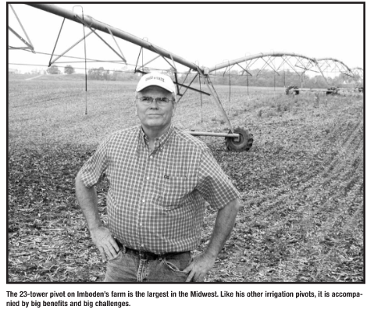
Agricultural Irrigation Demands
OSU professor estimates that by 2040 irrigation will be more widespread, driven by increasing temperatures
Estimated + 5-inces per year, supplemented in critical growing season (July / August / September)
Increases annual ground water demand by 9.15 BG across the entire 15-county area (0.02 MG to 1.16 BG per year at HUC-10 level)

Slide 83
Future Agricultural Demands
Daily use during growing season only (92 days)
OASIS NODE NUMBER | HUC 10 NUMBER | COUNTY | 2050 Additional Irrigation Demand (MGD)
9014 | 506000116 | DELAWARE | 0.04
9027 | 506000117 | FAIRFIELD | 0.118
9056 | 506000118 | FRANKLIN | 1.873
9061 | 506000122 | FRANKLIN | 2.742
9088 | 504000301 | KNOX | 0.719
9090 | 504000302 | KNOX | 3.609
9094 | 504000303 | KNOX | 2.838
9107 | 504000601 | LICKING | 1.947
9109 | 504000602 | LICKING | 2.138
9116 | 504000603 | LICKING | 0.472
9119 | 504000604 | LICKING | 0.533
9173 | 506000102 | MARION | 1.014
9202 | 506000123 | PICKAWAY | 3.97
9213 | 506000204 | PICKAWAY | 9.166
9233 | 506000106 | UNION | 0.124
9235 | 506000107 | UNION | 0.538
9503 | 503020402 | HOCKING, FAIRFIELD | 0.05
9515 | 504000304 | KNOX | 1.93
9524 | 504000605 | LICKING | 0.34
9525 | 504000606 | LICKING | 0.0003
9549 | 506000201 | MADISON | 1.42
9528 | 506000103 | MARION | 0.81
9529 | 506000104 | LOGAN | 1.46

Slide 84
Future Agricultural Demands
Daily use during growing season only (92 days)
OASIS NODE NUMBER | HUC 10 NUMBER | COUNTY | 2050 Additional Irrigation Demand (MGD)
9530 | 506000105 | MARION, DELAWARE, UNION | 3.97
9569 | 506000309 | ROSS | 2.41
9566 | 506000306 | FAYETTE, ROSS | 0.92
9500 | 506000308 | FAYETTE, MADISON | 1.19
9570 | 506000310 | ROSS | 1.87
9550 | 506000202 | FAYETTE, PICKAWAY, MADISON | 0.93
9534 | 506000109 | MORROW | 0.03
9535 | 506000110 | MARION, DELAWARE | 0.26
9544 | 506000119 | LOGAN, UNION | 1.4
9545 | 506000120 | MADISON, UNION | 0.5
9546 | 506000121 | MADISON, FRANKLIN | 0.27
9551 | 506000203 | ROSS, PICKAWAY | 1.64
9553 | 506000205 | ROSS, PICKAWAY | 5.03
9557 | 506000209 | ROSS, HOCKING | 0.002
9558 | 506000210 | ROSS | 2.46
9561 | 506000301 | FAYETTE, MADISON | 1.29
9562 | 506000302 | FAYETTE, MADISON | 0.28
9572 | 508000102 | LOGAN | 0.02
9574 | 508000104 | LOGAN | 4.56
9505 | 503020404 | HOCKING, FAIRFIELD | 0.21
9507 | 503020406 | HOCKING | 0.43
9573 | 508000103 | LOGAN | 12.61
9563 | 506000303 | FAYETTE | 0.09
9571 | 508000101 | LOGAN | 4.12
9575 | 508000115 | LOGAN | 9.14
9567 | 506000307 | ROSS | 5.93

