Slide 2


Ohio Family & Children First Fiscal Forum
December 12, 2023

Slide 3

agenda
Fiscal 101 (intro to new optional resource)
FYIs
Questions + Discussion

Slide 4

Ohio family & children first fiscal 101
DRAFT VERSION
DRAFT VERSION

Slide 5
Table of contents
DRAFT
4. Returning Unspent Funds (slide 19)
5. Fiscal Resources
OFCF website (slide 20)
Ohio Revised Code + Ohio Administrative Code (slide 21)
6. Administrative Agent Roles & Responsibilities (slide 22 – 23)
7. SEFA and Hinkle reporting (AOS) (slide 24)
​
1. Subgrant Agreement (ODJFS & FCFC) – (slide 4)
2. Allocation Chart Review – (slide 5-6)
Advancement vs Reimbursement
3. Reporting Requirements
Monthly expense reporting
OASCIS (slide 7-8)
Spreadsheet (slide 9)
CFIS counties only (slide 10)
Annual Pooled Fund reporting
Flexible/General (slide 11-14)
MSY/PCSA Restricted (slide 15-17)
OCBF application – (slide 18)

Slide 6
Subgrant agreement
DRAFT
ODJFS (now ODCY) and your FCFC have a signed subgrant agreement that spans two years. Current (SFY24-25).
The subgrant agreement is drafted by the State’s legal contracts department. The draft subgrant agreement is then sent to the FCFC administrative agent for review and signature. Once the signature is obtained by the AA, OFCF then forwards to State Director’s office for signature. The agreement is considered fully executed after signed by our Director and final copy is sent to the FCFC.
The subgrant agreement outlines key information needed to use the funding granted to your FCFC appropriately. Highlighted sections include:
Article I. Purpose of Subgrant Activities – attachment A outlines the purpose and responsibilities expected by the FCFC.
Article II. Effective Date of Subgrant – provides the date span of the agreement. This agreement is renewed each biennium.
Article III. Amount of Subgrant Payments – shows a biennium funding total and an annual funding total awarded to the FCFC.
Attachment A: Purpose and Deliverables - outlines specific deliverables the Administrative Agent is expected to adhere to, reporting requirements and deadlines for each funding stream.
Attachment B: Allocation Chart – displays the various funding categories and amounts awarded to each FCFC
Attachment C: FCSS Guidance Document – includes guidelines and requirements for utilizing FCSS funding properly, important definitions, reporting requirements and deadlines.
Attachment D: Pooled Fund Guidance Document - includes guidelines and requirements for utilizing Flexible/General and MSY/PCSA Restricted funding properly, important definitions, reporting requirements and deadlines.

Slide 7
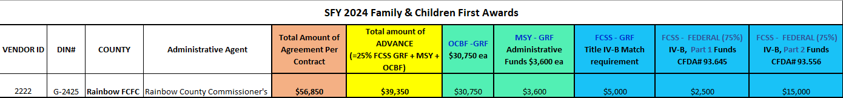
Allocation chart review
DRAFT
Administrative Agent = the entity designated to perform fiscal tasks on behalf of the FCFC
Total Amount of Agreement Per Contract = all funding awarded to the FCFC by OFCF for the fiscal year
Total Amount of Advance = all advancement funding awarded to the FCFC by OFCF to include (OCBF, MSY Admin and FCSS/State GRF)
​
Vendor ID – the internal State department identification number assigned to your Administrative Agent for issuing payments
DIN#
G stands for “Grant” as the type of agreement
XXXX - represents the last four digits of the agreement number assigned to your FCFC
County = county FCFC name

Slide 8
Allocation chart review
DRAFT
Reimbursement Funding:
FCSS Federal Part 1 = Family Centered Services and Supports funds derive from the Federal Stephanie Tubbs Jones Child Welfare Services program. Funding is issued as reimbursement via monthly expense reporting for PO counties.
FCSS Federal Part 2 = Family Centered Services and Supports funds derive from the Federal MaryLee Allen Promoting Safe and Stable Families program. Funding is issued as reimbursement via monthly expense reporting for PO counties.
​
Advancement Funding:
OCBF = Operational Capacity Building Funds are issued to FCFCs as an advancement. The funding source is State general revenue fund (GRF) dollars.
MSY Admin = Multi-System Youth administrative funds are issued to FCFCs as an advancement. The funding source is State general revenue fund (GRF) dollars.
FCSS – GRF = Family Centered Services and Supports funds are issued to FCFCs as an advancement. The funding source is State GRF dollars.

Slide 9
Reporting Requirements – Monthly Expenses to OFCF
DRAFT
OASCIS users
Ohio Automated Service Coordination Information System (OASCIS) - is the data system used by FCFCs to enter and manage program and expense data for the youth they serve.
OASCIS is required for monthly expense reporting of OCBF, MSY admin, FCSS and MSY/PCSA, unless the County FCFC has prior approval to submit expenses via the OFCF issued excel spreadsheet.
Reporting is due by the 10th each month (unless the 10th is a weekend or holiday, then the following Monday)
7078 form
An approved 7078 form must be on file to utilize OASCIS. If access to OASCIS is needed, please submit a completed 7078 form to our office mailbox ofcf_access@childrenandyouth.ohio.gov. Please contact our office requesting the form if needed. Also, be sure to notify us if staff leave their position so their account can be deactivated timely.
Note: if your Administrative Agent is Job & Family Services, a digital 7078 form must be submitted on the employee's behalf by county HR or technical point of contact. Once complete, our office will be notified of the submission and proceed with the approval process.
Resources
Our website includes several job aids and an expense training video as a resource for navigating OASCIS.
https://fcf.ohio.gov/fcfc-resources/oascis/ohio-automated-service-coordination-information-system
Office Hours – every other Wednesday via Teams
OFCF hosts OASCIS office hours to present new functionality, address system issues and provide technical assistance to users.

Slide 10
Reporting Requirements – Monthly Expenses to OFCF
DRAFT
OASCIS users
Reporting System Issues + Enhancement Requests
Please report all OASCIS login, and functionality issues to ofcf_access@childrenandyouth.ohio.gov.
OFCF staff monitor this mailbox daily and will respond to your inquiry asap.
You may find ways to enhance OASCIS as you use the system. Please report enhancement requests to ofcf_access@childrenandyouth.ohio.gov for consideration.

Slide 11
Reporting Requirements – Monthly Expenses to OFCF
DRAFT
Non-OASCIS users – Excel spreadsheet
Counties granted permission to use the Excel spreadsheet for reporting expense and program data can find the document on our website:
https://fcf.ohio.gov/fcfc-resources/fiscal-resources/fiscal-resources
FY Non OASCIS Required Monthly Expense and Data Report
This document is required for monthly expense reporting of OCBF, MSY admin, FCSS advancement and FCSS reimbursement
Since OCBF, MSY admin and FCSS/GRF are advancement payments, you are reporting how much was spent as a YTD amount
For FCSS/Federal reimbursement, this report submission is your request to be reimbursed for services and supports spent on youth. You will receive payment by either EFT or check depending on your administrative agent’s preferred method.
Reports are due by the 10th each month (unless the 10th is a weekend or holiday, then the following Monday)
Send submissions to ofcf@childrenandyouth.ohio.gov
.

Slide 12
Reporting Requirements – CFIS (County Finance Information System)
DRAFT
For CFIS counties only
FCFCs under the CFIS umbrella are broken out into two different county agencies (PA for Public Assistance/JFS and PCSA/Children Service Boards)
All OFCF funding flows via the County Finance Information System:
OCBF, MSY Admin, FCSS advancement and FCSS reimbursement
Multi-System Youth incentive payments (if applicable)
Note: if you are a county that uses OASCIS, the expenses entered in OASCIS are for data reporting purposes only. No actual money flows outside of CFIS.
The administrative agent is responsible for drawing down funds, transferring those funds to the FCFC and reporting expenses in CFIS.
We encourage FCFC Administrative Agent staff and the County Director/Coordinator to work together when developing a plan for drawing down funds, and reporting expenses timely and accurately within CFIS.
County Finance completes a quarterly reconciliation process to release additional funds requested by the AA or to recoup overages reported within CFIS.
OFCF is not the SME regarding how to use CFIS properly as we do not have access to the system. For technical assistance please contact:
BCFTA Help Desk: CFIS_Help_Desk@jfs.ohio.gov or 614-752-9194
.

Slide 13
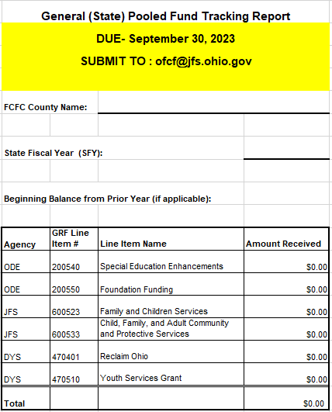
Annual pooled fund reporting flexible/General pooled fund
DRAFT
Purpose: State and local public agencies have the flexibility to transfer allocated State Funds to funding pools administered by the Family and Children First Council (FCFC).
Funds transferred to this funding pool can be used to assure access to needed services by families and children in the community.
FCFCs determine how the funds will be spent (except Admin costs)
Notes: Only complete this report if you receive funding in these specific GRF line items. It is due 9/30 each year.
Up to 10% of the annual amount of pooled funds transferred can be used by the FCFC to cover administrative cost.
Administrative costs are defined as those activities common to the fund in general, such as financial management, related audit costs, types and frequency of reports, and retention of records.
Where possible, the pooled funds shall be used as match for federal funds to the extent that the funds are not currently being used as match for other federal programs.
Unused funding may be carried over year to year until fully expended.
Ohio Family and Children First (OFCF) will provide the FCFCs with the reporting tool at the beginning of each SFY.
Statue language can be found in Pooled Fund Guidance document.
Annual reporting document can be found on our website:
https://fcf.ohio.gov/fcfc-resources/fiscal-resources/fiscal-resources
​
Notes:
There are two types of pooled funding: Flexible/General and MSY/PCSA Restricted.

Slide 14
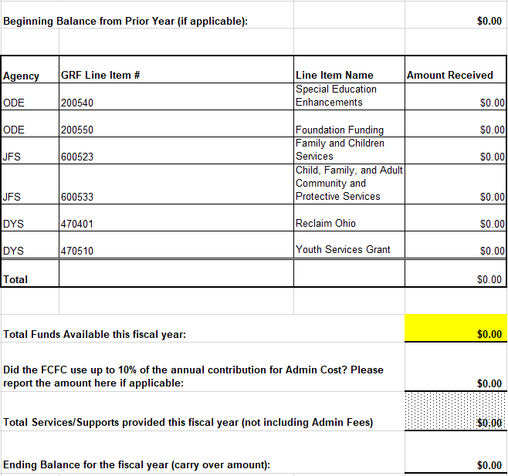
Annual pooled fund reporting flexible/General pooled fund
Calculation steps:
Enter balance from previous year
Enter amounts received for each line item
Total funds available this fiscal year = (beginning balance/prior year roll over + current allocation line items)
10% admin cost used? Enter amount.
Enter Service/supports provided (minus admin)
6. Ending balance for carry over
DRAFT
​
Notes:
There are two types of pooled funding: Flexible/General and MSY/PCSA Restricted.

Slide 15
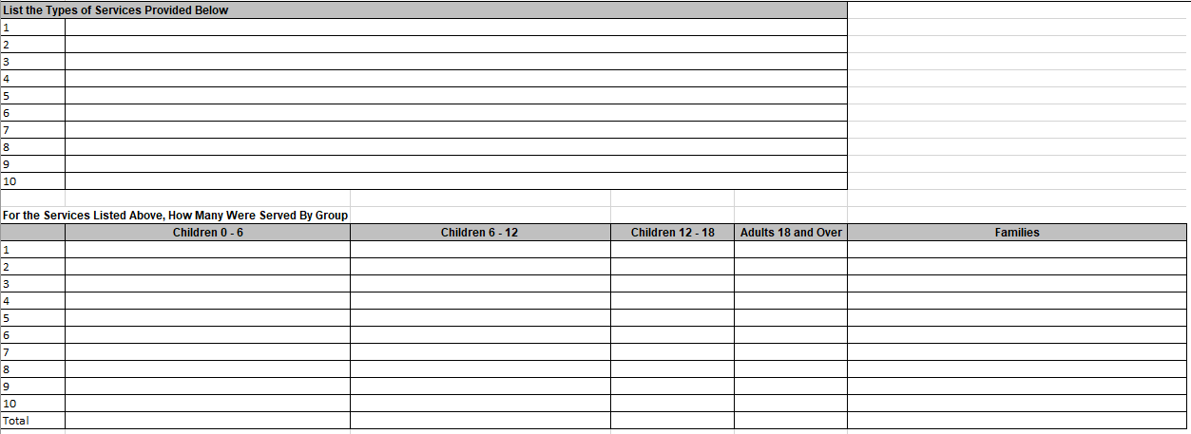
Annual pooled fund reporting flexible/General pooled fund
DRAFT
Program data steps:
List Services/Supports Provided
As determined by the FCFC’s written policy on how they use Flexible funds
Enter age range data for section above
​
Notes:
There are two types of pooled funding: Flexible/General and MSY/PCSA Restricted.

Slide 16
Annual Pooled Fund Reporting Flexible/General Pooled Fund
DRAFT
Narrative Section
Purpose/Problem: What is the purpose or problem the transfer of funds was to resolve?
What needs will be met using these funds?
What is the desired outcome of using these flexible dollars?
What goals did you have in mind when thinking about how to use these flexible funds in the beginning of the fiscal year?
What was the actual outcome of using these flexible dollars?
What did you actually achieve with using these flexible dollars?
Any identifiable measurable outcomes?
.
Notes:
There are two types of pooled funding: Flexible/General and MSY/PCSA Restricted.

Slide 17
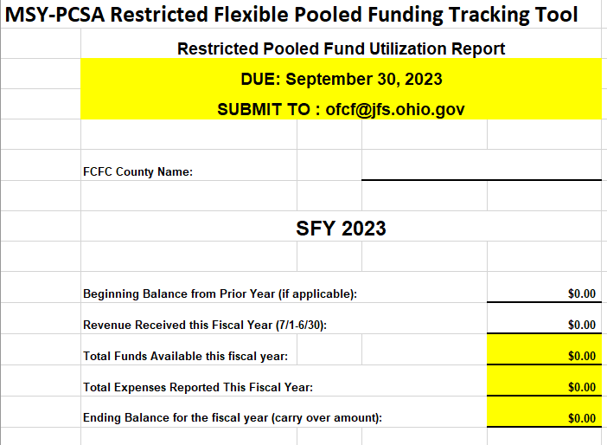
Annual pooled fund reporting msy/pcsa restricted pooled fund
DRAFT
Purpose: As outlined in Ohio Administrative Code 5101:2-54-01, portions of Multi-System Youth (MSY) allocations distributed by local Public Children Service Agencies (PCSA) must be designated to county Family and Children First Councils’ (FCFC) restricted pooled fund. The current minimum transferred to FCFCs is 12%. Use of these funds is restricted to providing services and supports needed to prevent the relinquishment of custody of children, 0-18, and to facilitate family reunification following a custodial episode.
Note: report is due 9/30 each year.
Annual reporting document can be found on our website:
https://fcf.ohio.gov/fcfc-resources/fiscal-resources/fiscal-resources
For Non-OASCIS counties only beginning SFY24
Calculation steps:
Enter balance from previous year
Enter revenue received for current year
Total funds calculated (previous + current funds)
Enter total expenses
Ending balance calculated (total funds – total expenses)
​
Notes:
There are two types of pooled funding: Flexible/General and MSY/PCSA Restricted.

Slide 18
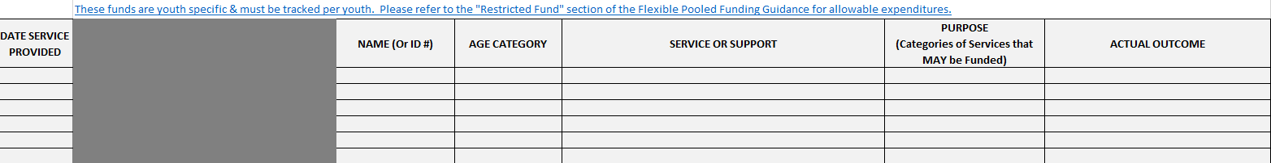
Annual Pooled Fund Reporting msy/pcsa restricted pooled fund
DRAFT
.
Date of Service
Name or Youth ID
Age Category (drop-down menu)
0-3, 4-9, 10-13, 14-18
Service or Support (drop-down menu)
Various options as listed in guidance document such as mentoring, respite, service coordination, high-fidelity wraparound etc.
Purpose (drop-down menu)
Four options to choose from; all related to preventing custody relinquishment
Actual Outcome (drop-down menu)
Four options to choose from; select best fit
Notes:
There are two types of pooled funding: Flexible/General and MSY/PCSA Restricted.

Slide 19
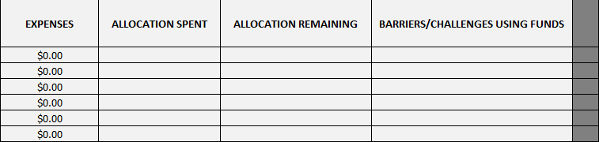
Annual Pooled Fund Reporting msy/pcsa restricted pooled fund
DRAFT
.
Expenses
Enter expense amount for each service provided to youth
Allocation Spent
Spreadsheet will calculate the amount of allocation spent line by line
Allocation Remaining
Spreadsheet will calculate the remaining allocation amount line by line
Barriers/Challenges using funds
Provide any information regarding barriers or challenges faced when utilizing funding (if applicable)
Notes:
There are two types of pooled funding: Flexible/General and MSY/PCSA Restricted.

Slide 20
OCBF Application Requirement
DRAFT
Each year our office requires all FCFCs to complete an OCBF (Operational Capacity Building Fund) application. The application is sent to FCFCs via email and is due in April prior to the start of a new fiscal year. A completed application and meeting minutes approving the application must be submitted to our office in order to receive OCBF funding.
Application data collected:
Chair and Council Coordinator – contact information
Application Guidelines
Budget Summary
Share plan for how your FCFC plans to spend OCBF funding
County FCFC Full Council Meetings
Provide the date and time of each scheduled full county FCFC meeting for the SFY
Mandated Members Attendance for Calendar Year
Mark if attendance requirement is met for mandated members
Note regarding county FCFC meeting minutes requirement
Signature page for FCFC Chair and Administrative Agent
Signature page for parents
Obtain signatures from parents that have committed to be representatives for the upcoming SFY
Checklist
Submit application + meeting minutes to: ofcf@childrenandyouth.ohio.gov

Slide 21
Returning Unspent Funds
DRAFT
We highly encourage FCFCs to spend their entire allocation for all funding awarded, but there are instances where money may need to be returned to the State office.
PO Counties Process
Once a full and complete internal reconciliation is done and your FCFC determines funding must be returned to the State, please reach out to the OFCF Financial Program Manager. He/She will respond with instructions for sending money back to the State. Provide the following information in your initial communication to our office:
Funding source being returned: OCBF, MSY admin, FCSS advancement or FCSS reimbursement
Amount of each funding source being returned
When our fiscal department can expect to receive the payment
Payment must be made using a check. The State does not currently have an option to accept money via EFT.
CFIS Counties Process
Bureau of County Finance completes a quarterly reconciliation in the County Finance Information System. This process 1) issues additional funding requested by the FCFC and 2) recoups overages reported by the Administrative Agent. If an unspent amount has been identified by the FCFC, please ensure this is reflected in CFIS. When the unspent amount is entered in CFIS by 9/30 of the next state fiscal year, there is no need to contact OFCF regarding your unspent balance.
Example: SFY23 (July 1, 2022 – June 30, 2023) overage found = 9/29/23 deadline for final quarterly reconciliation
If an unspent amount is found after the quarterly reconciliation deadline, please contact our office using the PO counties process explained above. A check payment must be sent to the State at this point.
Note: If an FCFC routinely has unspent funds, this may be taken into account in the future when OFCF explores recalculating county allocations.

Slide 22
Fiscal Resources
DRAFT
OFCF website
FCFC Resources: https://fcf.ohio.gov/fcfc-resources
OASCIS: https://fcf.ohio.gov/fcfc-resources/oascis/ohio-automated-service-coordination-information-system
Key dates: https://fcf.ohio.gov/fcfc-resources/key-dates/sfy-key-dates-document
Fiscal Resources: https://fcf.ohio.gov/fcfc-resources/fiscal-resources/fiscal-resources
Family Centered Services and Supports (FCSS): https://fcf.ohio.gov/fcfc-resources/fiscal-resources/family-centered-services-and-supports-fcss-funding
Funding Information: https://fcf.ohio.gov/fcfc-resources/fiscal-resources/funding-information
Operational Capacity Building Funds: https://fcf.ohio.gov/fcfc-resources/fiscal-resources/operational-capacity-building-funds
MSY TA & Funding Applications: https://fcf.ohio.gov/msy-ta-and-funding-applications
All Events: https://fcf.ohio.gov/home/news-and-events/all-events

Slide 23
Fiscal Resources
DRAFT
Ohio Revised Code (ORC)
Section 121.37 – Ohio Family and Children First Cabinet Council: https://codes.ohio.gov/ohio-revised-code/section-121.37/10-3-2023
Section 121.376 – Ohio Automated Service Coordination Information System: https://codes.ohio.gov/ohio-revised-code/section-121.376
Section 121.373 – Family and Children First Administration Funds: https://codes.ohio.gov/ohio-revised-code/section-121.373
Section 121.381 – Family and Children First Dispute Resolution Process: https://codes.ohio.gov/ohio-revised-code/section-121.381
Ohio Administrative Code (OAC)
Rule 5101:9-6-24 – Multi-system youth (MSY) funding: https://codes.ohio.gov/ohio-administrative-code/rule-5101:9-6-24

Slide 24
Administrative Agent Roles & Responsibilities
DRAFT
The actual role and responsibilities of the Administrative Agent may vary council to council. ORC 121.37 outlines some general guidelines for AAs to follow as highlighted below:
(5)(a) Each county council shall designate an administrative agent for the council from among the following public entities: the board of alcohol, drug addiction, and mental health services, including a board of alcohol and drug addiction or a community mental health board if the county is served by separate boards; the board of county commissioners; any board of health of the county's city and general health districts; the county department of job and family services; the county agency responsible for the administration of children services pursuant to section 5153.15 of the Revised Code; the county board of developmental disabilities; any of the county's boards of education or governing boards of educational service centers; or the county's juvenile court. Any of the foregoing public entities, other than the board of county commissioners, may decline to serve as the council's administrative agent.
A county council's administrative agent shall serve as the council's appointing authority for any employees of the council. The council shall file an annual budget with its administrative agent, with copies filed with the county auditor and with the board of county commissioners, unless the board is serving as the council's administrative agent. The council's administrative agent shall ensure that all expenditures are handled in accordance with policies, procedures, and activities prescribed by state departments in rules or interagency agreements that are applicable to the council's functions.
The administrative agent of a county council shall send notice of a member's absence if a member listed in division (B)(1) of this section has been absent from either three consecutive meetings of the county council or a county council subcommittee, or from one-quarter of such meetings in a calendar year, whichever is less. The notice shall be sent to the board of county commissioners that establishes the county council and, for the members listed in divisions (B)(1)(b), (c), (e), and (l) of this section, to the governing board overseeing the respective entity; for the member listed in division (B)(1)(f) of this section, to the county board of developmental disabilities that employs the superintendent; for a member listed in division (B)(1)(g) or (h) of this section, to the school board that employs the superintendent; for the member listed in division (B)(1)(i) of this section, to the mayor of the municipal corporation; for the member listed in division (B)(1)(k) of this section, to the director of youth services; and for the member listed in division (B)(1)(n) of this section, to that member's board of trustees.
Reference https://codes.ohio.gov/ohio-revised-code/section-121.37

Slide 25
Administrative Agent Roles & Responsibilities
DRAFT
The actual role and responsibilities of the Administrative Agent may vary council to council. ORC 121.37 outlines some general guidelines for AAs to follow as highlighted below:
The administrative agent for a county council may do any of the following on behalf of the council:
(i) Enter into agreements or administer contracts with public or private entities to fulfill specific council business. Such agreements and contracts are exempt from the competitive bidding requirements of section 307.86 of the Revised Code if they have been approved by the county council and they are for the purchase of family and child welfare or child protection services or other social or job and family services for families and children. The approval of the county council is not required to exempt agreements or contracts entered into under section 5139.34, 5139.41, or 5139.43 of the Revised Code from the competitive bidding requirements of section 307.86 of the Revised Code.
(ii) As determined by the council, provide financial stipends, reimbursements, or both, to family representatives for expenses related to council activity;
(iii) Receive by gift, grant, devise, or bequest any moneys, lands, or other property for the purposes for which the council is established. The agent shall hold, apply, and dispose of the moneys, lands, or other property according to the terms of the gift, grant, devise, or bequest. Any interest or earnings shall be treated in the same manner and are subject to the same terms as the gift, grant, devise, or bequest from which it accrues.
(b)(i) If the county council designates the board of county commissioners as its administrative agent, the board may, by resolution, delegate any of its powers and duties as administrative agent to an executive committee the board establishes from the membership of the county council. The board shall name to the executive committee at least the individuals described in divisions (B)(1)(b) to (h) of this section and may appoint the president of the board or another individual as the chair of the executive committee. The executive committee must include at least one family county council representative who does not have a family member employed by an agency represented on the council.
(ii) The executive committee may, with the approval of the board, hire an executive director to assist the county council in administering its powers and duties. The executive director shall serve in the unclassified civil service at the pleasure of the executive committee. The executive director may, with the approval of the executive committee, hire other employees as necessary to properly conduct the county council's business.
(iii) The board may require the executive committee to submit an annual budget to the board for approval and may amend or repeal the resolution that delegated to the executive committee its authority as the county council's administrative agent.
Reference https://codes.ohio.gov/ohio-revised-code/section-121.37

Slide 26

SEFA & HINKLE Reporting (Auditor of State)
DRAFT
HINKLE
FCFCs may be subject to HINKLE reporting. The Auditor of State website includes important information to help FCFCs comply with reporting requirements:
https://ohioauditor.gov/financialreporting/default.html
OFCF staff do not oversee SEFA and HINKLE reporting. Please reach out to your AOS regional contact for TA: https://ohioauditor.gov/contact.html
SEFA
FCFCs may be subject to Schedule of Expenditures of Federal Awards (SEFA) reporting inquiries. The Auditor of State may request verification of the Federal awards you receive as a subrecipient.
Key points to know when responding to an Auditor’s requests:
FCFCs receive Federal funding under FCSS reimbursement only
Federal funding is split between two CFDAs:
FCSS Federal 75% IV-B Part 1 = CFDA 93.645
FCSS Federal 75% IV-B Part 2 = CFDA 93.556
Confirm actual part 1 and 2 awards using the SFY allocation chart related to the audit year in question.
https://ohioauditor.gov/resources/federal_general.html
​

Slide 27

fyi
Administrative Agent (AA) Designations – SFY25
Survey link sent to Coordinators/Directors on 11/29/23
All counties are required to submit a survey response
Any AA change requires meeting minutes with council’s approval sent to ofcf@childrenandyouth.ohio.gov
Due date: 2/12/24
Fiscal Check Ins
Will start January 2024
Detailed fiscal review of OCBF, MSY Admin and FCSS expense reporting
I will be reaching out to counties with questions or concerns
Please start forecasting spending for the remaining fiscal year
Reallocation discussions will begin early 2024
Best Practice Training and Incentives – Each county is required to complete one!
HFWA training and incentive payment for 11 counties (missed SFY23 trainings): $7,500​
Service Coordination training and incentive payment for 88 counties: $4,744​
Must complete COE survey in order to receive certificate of completion and incentive payment
First round of payments will be issued this month!

Slide 28
fyi
Reminder - OASCIS Expense Reporting​
OCBF and MSY Admin expenses must be reported in OASCIS using the Agency Allocation Management screen​
MSY/PCSA youth expenses must be reported in OASCIS under youth specific case records​
Reminder - OASCIS Allocations​
Please be sure to enter MSY/PCSA allocations​
12% minimum transferred from PCSAs to FCFCs​
SFY24 OASCIS annual allocation = (SFY23 carryover amount + SFY24 allocation)​
OCBF Applications
Coming January 2024 – due April 11, 2024
Good time to start planning council meeting for approval.

Slide 29
Next Fiscal Forum - 2/13/24
Topic suggestions welcome!
Attendance is optional.
Teams calendar invites will be sent soon.
2024 Fiscal Forum Dates
Tuesday, February 13th | 10am -11am
Tuesday, April 9th | 10am -11am
Tuesday, June 11th | 10am -11am
Tuesday, August 13th | 10am -11am
Tuesday, October 16th | 10am -11am
Tuesday, December 10th | 10am -11am

Slide 30

Questions/discussion

