Slide 1


Business Tax Refunds and Overpayments
Commercial Activity (CAT) & Sales/Use Tax
Presented by Grant Weaver
Supervisor-Business Tax Division

Slide 2

Agenda
“The Buckeye Refund”
Senate Bill 263
Why do overpayments exist?
How to file a refund claim
Refund claim process
Refund claim appeal process
Tax Alerts
Contact us

Slide 3

The Buckeye Refund
Phrase coined in a “Wall Street Journal” article published on Jan.16, 2013.
Tax Commissioner ordered the review of all tax computer systems to identify and fix inefficiencies in regards to tax overpayments.
Ohio’s Governor, John Kasich, instructed the Department of Taxation to refund overpayments within the 4 year statute of limitations and to audit returns for businesses that may have overpaid their taxes.
Refunds issued to date due to this project:
CAT: $12,192,818
Sales/Use Tax: $ 10,567,650
CFT: $ 7,801,056
EWH: $ 997,643
SDWH: $ 43,922
Total: $ 31,603,089

Slide 4
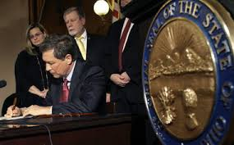
Senate Bill 263
Genesis
The Department of Taxation approached the General Assembly and proposed legislation in regards to refunding tax overpayments.
Legislation was passed unanimously
Ohio is the first and only state that statutorily requires refunds of tax overpayments.

Slide 5
Senate Bill 263 - Cont’d
Enacted on September 17, 2014 – R.C. 5703.77
No later than 60 days before the expiration of statute, the taxpayer will be notified of any credit account balance.
Credit balance can be applied as a credit against their liability for the tax or fee in the next reporting period or refunded.
The refund will be offset by the amount of the taxpayer’s tax debt certified to the Attorney General.

Slide 6
Senate Bill 263 - Cont’d
Senate Bill 263’s impact on the refund/overpayment process
Prior to SB 263
Required to file refund claim
No notification
If refund claim was not filed, overpayments went out of statute
After SB 263
Taxpayers must be notified of any overpayments
Refund will be issued after offsets are taken in consideration
Ohio Business Gateway (OBG)
If valid overpayment exists in the preceding tax period, upon filing the current tax period, OBG will display the credit amount and apply it to the current period’s liability (CAT only).
Taxpayers with a valid sales/use tax credit balance will receive notification and may request that the credit be transferred to the current period. The amount will prepopulate as a credit on OBG.

Slide 7

Business Tax Overpayments
Why do business tax overpayments exist?
Amended returns
Situsing issues
Taxability issues
Tax miscalculations
Duplicate payments
Refundable tax credits (CAT)
Overpayment of the annual minimum tax (CAT)
Motor vehicle claims (sales/use tax only)
Accelerated payments (sales tax only)

Slide 8

How to File a Refund Claim
CAT
Complete form CAT REF
Amended return overpayment letter may serve as substitute.
May be submitted via mail or uploaded via OBG.
Sales/Use Tax
Complete form ST AR
Unrequested refund letter (URAT) may serve as substitute.
Must be submitted via mail.
Statute:
Refund claim must be postmarked within four years from the date of the overpayment of the tax (R.C. 5739.07 (Sales) and 5751.08 (CAT))

Slide 9
How to File a Refund Claim – Cont’d
Supporting Documentation
In order to expedite the processing of refund claims, please supply the following documentation (if applicable):
Invoices
Spreadsheet listing transactions (in electronic format if greater than 25 invoices)
Proof of payment
State by state sales breakdown
Contracts
Tax credit certificates and form CAT CS (CAT only)

Slide 10
How to File a Refund Claim – Cont’d
Common Sales Tax Refund Claim
Taxability-exemption certificate received after return was filed. The following supporting documentation is needed:
Refund Application
Invoice(s)
Credit memo
Exemption certificate
Common Use Tax Refund Claim
Taxability-paid use tax on an item that was exempt. The following supporting documentation is needed:
Refund Application
Invoice(s)
Use tax accruals
Reason as to why the items are being deemed exempt
Common Sales/Use Tax Refund Claim
Customer direct refunds-customers can file a refund claim for taxes paid to a vendor in error.
Refund Application
Invoice(s) or receipts
Proof of Payment
Reason as to why the items are being deemed exempt

Slide 11
How to File a Refund Claim – Cont’d
Common CAT Refund Claims
Amended return filed to exclude out of state sales reported on original return. The following supporting documentation is needed:
Refund Application
State by state breakdown of sales and/or breakdown of Ohio sales by customer/invoice (electronic file format is recommended).
Sample of invoices to demonstrate that a “ship to” destination is present.
Original/amended return filed to claim a tax credit. The following supporting documentation is needed:
Refundable Credits
Refund application
Form CAT CS (credit schedule)
A copy of the tax credit certificate issued by DSA (if applicable)
Non-Refundable Credits (amended return only)
Refund application
Copy of the tax credit certificate issued by DSA (if applicable)
A calculation of the tax credit (qualified research expense only)
Copy of federal form 6765.
Address where qualified research was conducted.

Slide 12
How to File a Refund Claim – Cont’d
Common Mistakes and/or Misconceptions
Incomplete Refund Applications
No signature
No reason stated as to why a refund is being requested.
Lack of sufficient supporting documentation
No TBOR-1 on file for taxpayer representatives.
Statute
Four years from the date of overpayment (not based on due date of return).
The amendment of a return, resulting in an overpayment, does not preserve statute. A refund claim must be filed.

Slide 13

Refund Claim Review Process
All claims received will be date stamped by the Business Tax Division and assigned to an agent.
Agents will review the claim for its validity and, if needed, contact the taxpayer regarding insufficient supporting documentation via phone, email, and/or mail.
On average, refund claims are processed 4-6 weeks upon receipt.
Claims may be referred to the Audit Division due to various reasons:
Concurrent audit being conducted
Multiple taxability issues
Refund claim may require a plant tour

Slide 14
Refund Claim Review Process – Cont’d
Refund claims shall be approved in full/part or denied.
Approved in full
Tax (plus interest)
Approved in part or denied in full
Tax (plus interest) on approved portion
Claimant is sent an “approved in part” or “denied in full” letter via mail. Taxpayer has 60 days from the date of mailing to respond with additional supporting documentation and/or request a hearing or the claim is final (R.C. 5703.70)
Any documentation received during the 60 day appeal period is sent to the Tax Appeals Division for review.
Offsets
Taxpayers do not have appeal rights for refunds that were fully approved, but subsequently offset.

Slide 15

Refund Claim Appeal Process
All responses/documentation received in response to a refund approved in part or denial letter shall be transferred to the Tax Appeals Division.
Applicant will receive a letter indicating that the claim is being transferred.
The claimant may request to schedule a hearing.
If a hearing is not requested, the refund will be allowed, allowed in part, or denied and a final determination (FD) will be issued based on any additional information submitted.
If a hearing is requested, the refund will be assigned to an attorney who will hold a hearing in due course, prior to the issuance of a FD.

Slide 16
Refund Claim Appeal Process – Cont’d
Presenting your case at the hearing
Be prepared – arguments should be provided in writing
Provide specifics – not conclusions
Provide all additional documentation & evidence
Upon request, time will be allowed after the hearing to submit additional information.
Final Determinations
Per R.C. 5703.70(C), a final determination shall be drafted per the outcome of the appeal process.
Per R.C. 5717.02, the taxpayer has 60 days to appeal the final determination. Upon expiration of the allotted timeframe, the matter will be concluded and the file closed.

Slide 17

Tax Alerts
Please subscribe to the Ohio Department of Taxation’s tax alerts to stay up to date on CAT and sales/use tax law.
http://www.tax.ohio.gov/ohtaxalert.aspx

Slide 18
Contact Us
General Information for Sales & Use Tax
Phone: 1-888-405-4039
P.O. Box 530, Columbus, OH 43215
Or visit tax.ohio.gov
General Information for CAT
Phone: 1-888-722-8829
P.O. Box 16158, Columbus, OH 43216
Or visit tax.ohio.gov

Slide 19
Personal and School District Income Tax Refunds and Overpayments
Teakilla Phillips
Tax Commissioner Agent Supervisor 2
Personal & School District Income Tax Division

Slide 20

Why Overpayments Occur?
Reported withholding
Tax rate changes
Duplicate payments/Estimated payments/Credit carry-forwards
Reconciling to the Federal Return
How to Claim a Refund

Slide 21
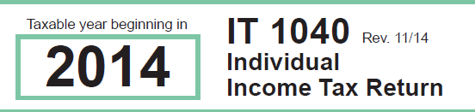
Potential Volumes

Slide 22
Too Much Withholding - PIT
IT 4 – Employee’s Withholding Exemption Certificate
Select option that results in
too much withholding
Review IT 4 when life changes happen
Marriage/Divorce
Birth of children
Change in jobs

Slide 23
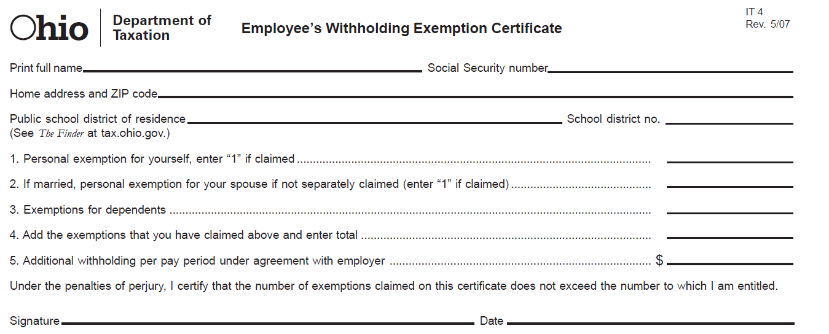
IT 4 (cont’d)
Teacher example

Slide 24

Too Much Withholding – School District
Forgot to tell employer you moved
Results in too much W/H for one
school district
Employer withholds for wrong school district
Results in overpayment in wrong district;
underpayment in correct district

Slide 25
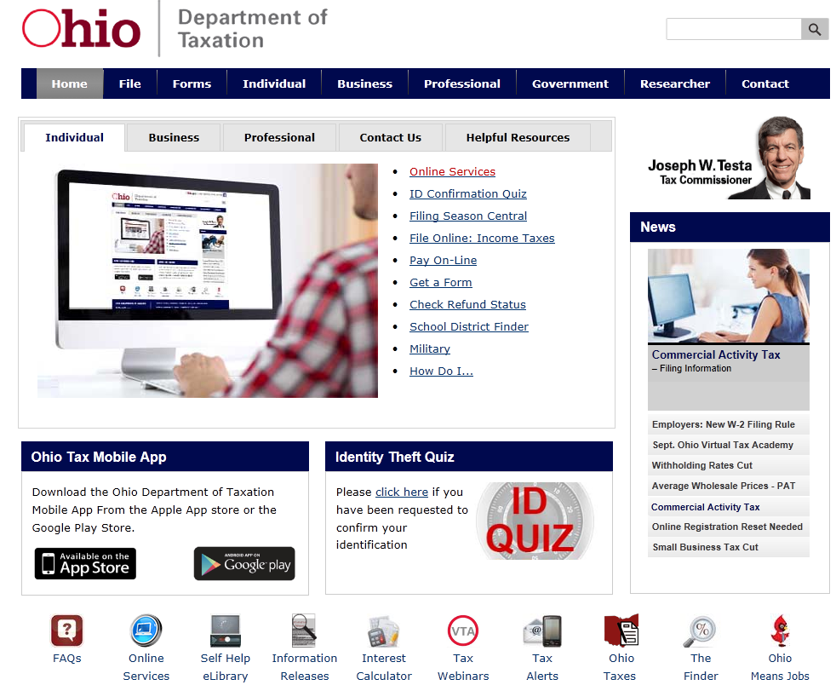
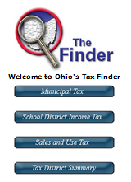
The Finder

Slide 26
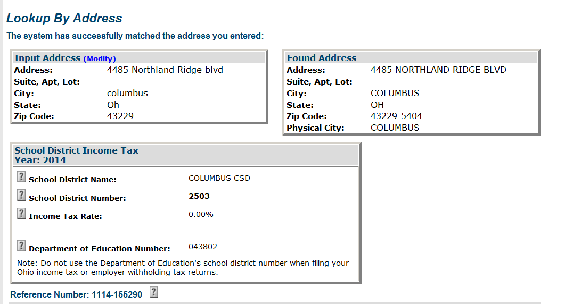
The Finder (continued)

Slide 27

Tax Rate Changes
Tax tables changing
Rate reduction since 2005
21% over 5 years beginning in 2005
Additional 10% in 2013-2014 returns
Another 6.3% for 2015 returns
Withholding table changes
Typically happens mid-year

Slide 28
Exemption/Dependent Deduction
HB 483
Provides for a graduated personal/dependent exemption amount
Ohio Adjusted Gross Income | Personal/Dependent Exemption
up to $40,000 | $2,200
>$40,000 - <$80,000 | $1,950
> $80,000 | $1,700

Slide 29

Duplicate Payments/Estimated Payments/Credit Carry-Forward
Issues resulting in overpayment:
Duplicating a payment
Not claiming all estimated payments made
Forgetting or not knowing an estimated payment was cancelled
Income not as much as projected
Forgetting or not reporting credit carry-forward from prior year return
New tax preparer and no copy of prior year return

Slide 30
Ohio Offsets
Capture refunds and apply to outstanding liabilities provided under Ohio law or federal mandate
Offset Types
Ohio Tax Assessment
Back Child Support
Public Assistance
Attorney General’s Office (AGO) Miscellaneous Debts – examples: university fees, BMV fees, etc.
Bureau of Workers’ Compensation
Internal Revenue Service

Slide 31
Offset Stats
Calendar year 2015 | Number of Offsets | Offset Amounts
Ohio Tax Assessment | 146,332 | $24,971,502
Back Child Support | 50,382 | $9,523,286
Public Assistance | 3,169 | $583,374
AGO Miscellaneous Debts | 161,690 | $29,302,188
Bureau of Workers’ Compensation | 537 | $27,194
Internal Revenue Service | 22,156 | $5,342,563

Slide 32

Online Payment Verification
Verify payments online prior to filing
Electronic payments
Paper checks
Cancelled payments
Credit carry-forwards

Slide 33
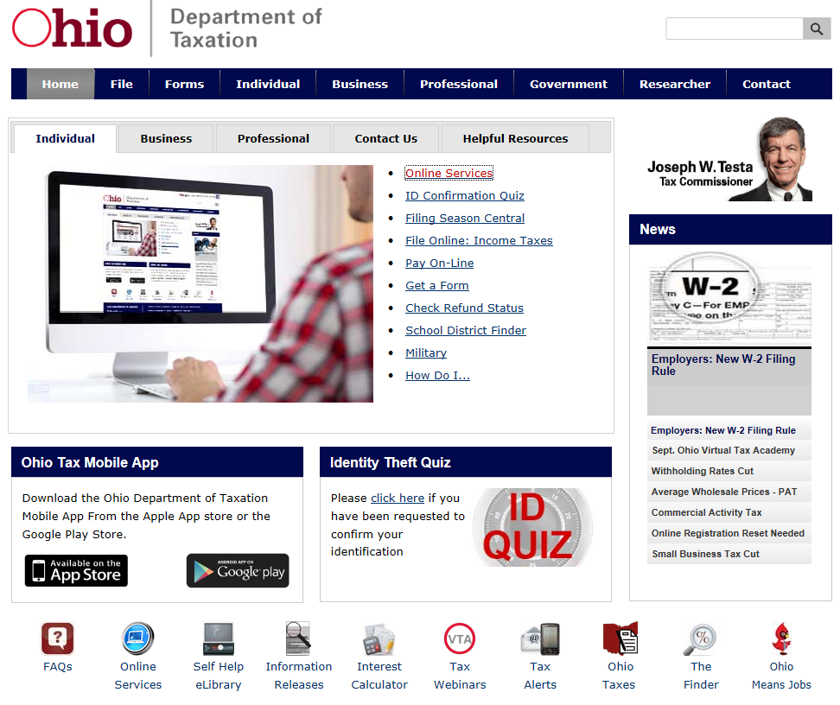
Online Services

Slide 34
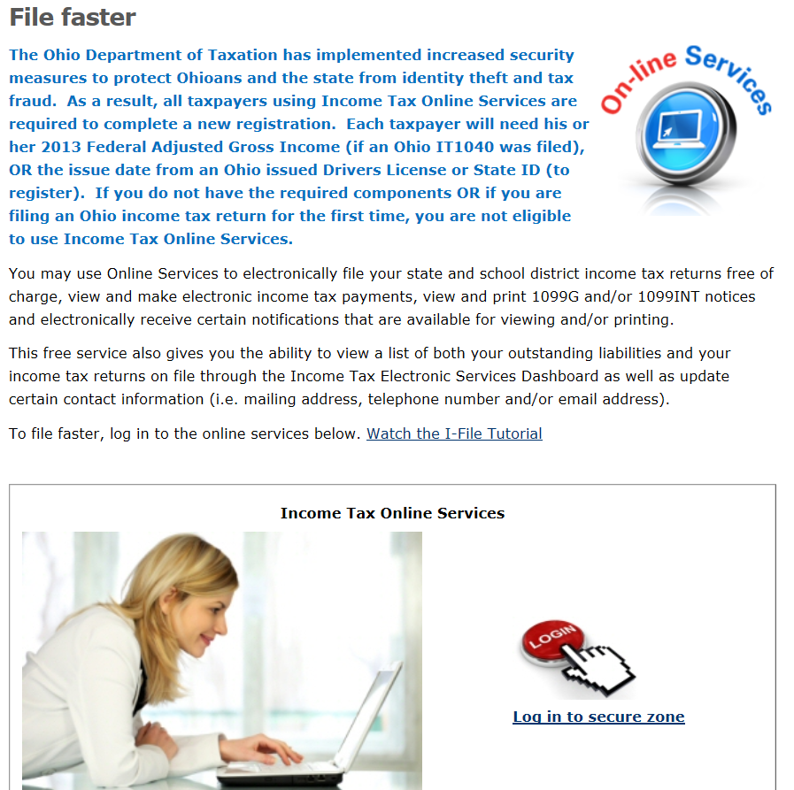

Slide 35
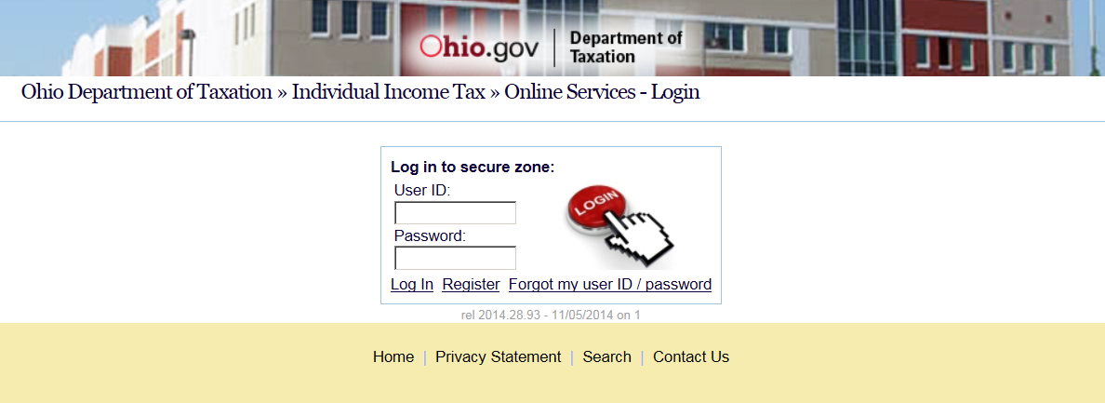
Register

Slide 36
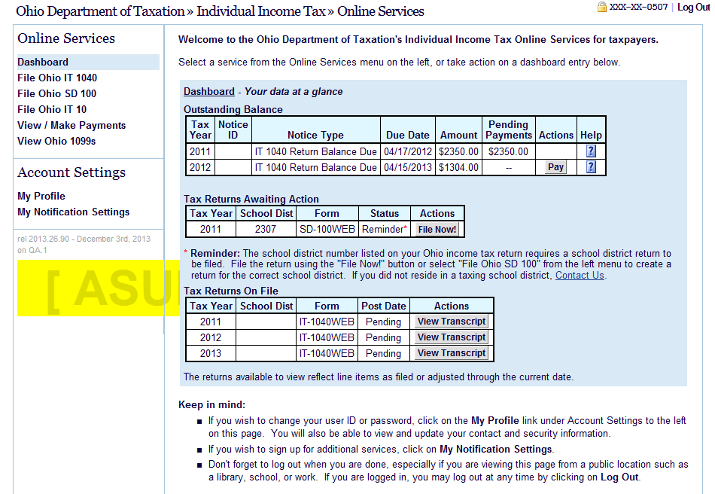

Slide 37
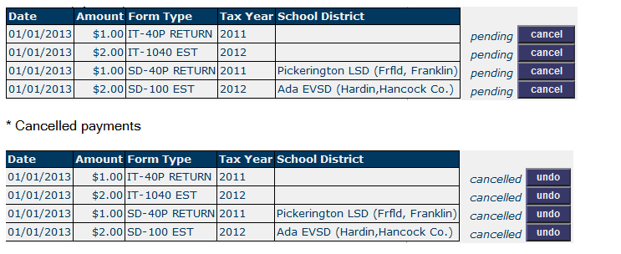
View All Payments/Credits

Slide 38
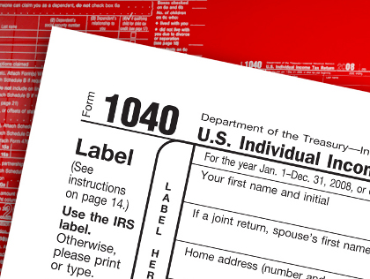
Reconciling to Federal Return
Key federal return line items:
Federal adjusted gross income
Exemptions
Filing status

Slide 39

ORC Governing Refunds
5747.11 Refunds
Except as otherwise provided…applications for refund shall be filed with the Tax Commissioner, on the form prescribed, within 4 years of the overpayment of the tax.
Upon receipt of the application, the Commissioner shall determine the amount of refund due

Slide 40

How to Claim the Refund
File original return
File amended return
2014 & back; separate form IT 1040X
2015 & forward; universal form IT 1040
Answer “Yes” to “Are you filing this as an amended return?”
Available for electronic filing
IT AR – Application for Personal Income Tax Refund
Form available at tax.ohio.gov
List amount & reason for requested refund
May be used if tax period is assessed

Slide 41

Review of the Refund Claim
System review – 4.1M returns YTD
Hundreds of business rules in tax processing system
Part of nightly return processing
Does not require manual intervention
Dependent example
Recalculation of return

Slide 42

Review of the Refund Claim (cont’d)
Manual review – 300,000 returns YTD
Did not pass system business rules
May need to request additional information
Depending on response, or if response is received,
overpayment is corrected/released
Increases turnaround time for refund

Slide 43
Petition of Assessment/Final Determination
Form PR – Petition for Reassessment
Mail form to:
Ohio Department of Taxation
Administrative Review Section
P.O. Box 1090
Columbus, OH 43216-1090
Compliance Division will determine if the information needed to make an adjustment has been received.
If so, Compliance Division will make adjustments and send a Notice of Corrected Assessment.
If not, Compliance Division will contact the taxpayer via phone or send a petition form letter.
If no response is received, a Final Determination letter will be issued affirming the assessment.

Slide 44

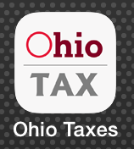
Checking Refund Status
Check your refund status at:
www.tax.ohio.gov….”Check Refund Status”
Mobile app….”Check My Refund Status”
Download mobile app from Apple or Google Play stores
Scan barcode to download

Slide 45
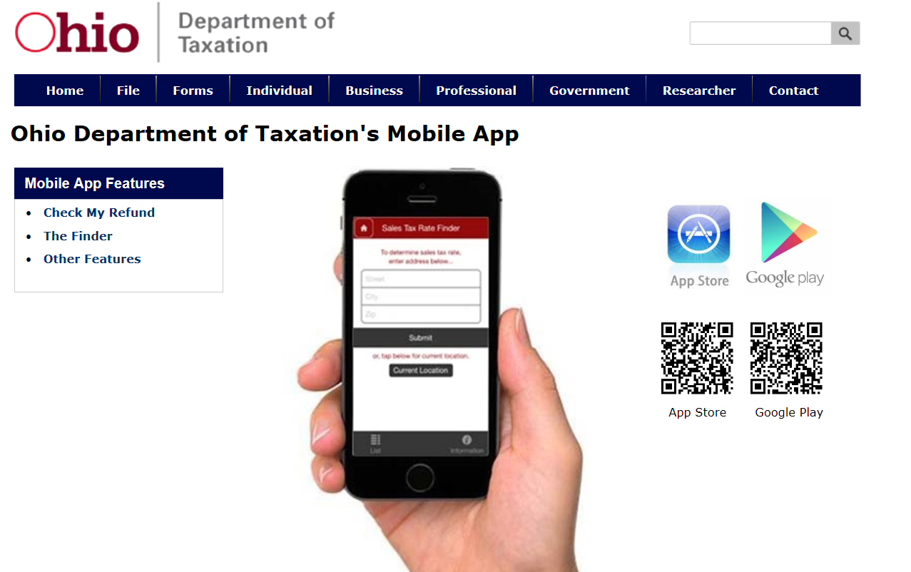

Slide 46
Unapplied Payment Program… Not always an Overpayment
Situations where an overpayment exists but taxpayer has not filed a return/requested refund
2 pilot programs
Approx. 1,500 taxpayers notified via letter
Approx. 20% responded/ filed return
May or may not have resulted in a refund
2nd notice send to individuals that did not respond
Verified income from IRS data
May still result in refund
May result in bill to taxpayer; need to file return

Slide 47
Coming Soon…
Next OVTA tentatively scheduled for November 18, 2015
Topics to include:
Legislative impacts to tax year 2015 filing
Changes to the 2015 income tax forms
New & Renewing School Districts
Notifications to Practitioners/Taxpayers upon filing electronically
Exemption from Business Income & New Flat Tax
Fraud
Stats on attempted fraud
Changes to tax return processing
No “Get out of Jail Free cards!”
Changes to Online Services Registration

Slide 48
Contact Us & Information
Information for Personal & School District Income Tax
800-282-1780 (General #)
614-728-1055 (Tax Practitioner #)
Via e-mail at tax.ohio.gov “Contact Us”
Survey for your feedback of how we are doing
Sign up for tax alerts
Download mobile app

