Slide 1

What to Expect During a Sales/Use Tax Audit
Debra Day, Tax Auditor Agent
William Bower, Tax Audit Manager

Slide 2
What to Expect During a Sales/Use Tax Audit
5 “W’s & H” of
  Who
  What
  Where
  When
  Why
  How Long and How to Complete

Slide 3
“What” is a Sales/Use Tax Audit
A sales tax audit is
    A formal review of a business taxpayer’s sales and sales tax returns to confirm:
        Sales tax has been properly collected from customers and remitted to the State of Ohio
        Exempt sales have been properly documented
            Example: blanket/unit certificate
Exemption Certificates can be found at: http:www.tax.ohio.gov/Forms.aspx

Slide 4
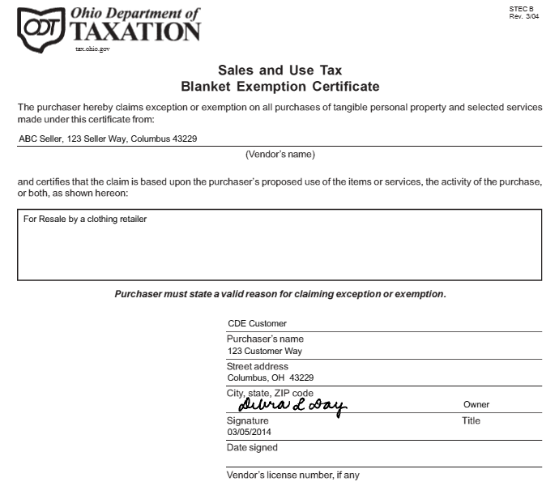
What to Expect During a Sales/Use Tax Audit

Slide 5
What to Expect During a Sales/Use Tax Audit
Sales tax audits normally encompass the most current three years unless;
    The audit is for failure to remit sales tax collected – audit will include all periods non remitted
Sales tax is a trust tax; therefore if a sales audit liability exists a Concurrent Responsible Party assessment will also be generated
Stiff penalties also apply to sales audits

Slide 6
“What” is a Sales/Use Tax Audit
A use tax audit is:
    A formal review of a business taxpayer’s purchase history to ensure:
        Sales tax has been properly charged and paid on all taxable purchases, or
        If sales tax was not properly charged,
        Use tax has been self-accrued and paid to the State
Use tax audits normally encompass the most current three years unless;
    Taxpayer has not filed use tax returns, then audit will encompass 7 years
Use tax audits will not have a Concurrent Responsible Party Assessment

Slide 7
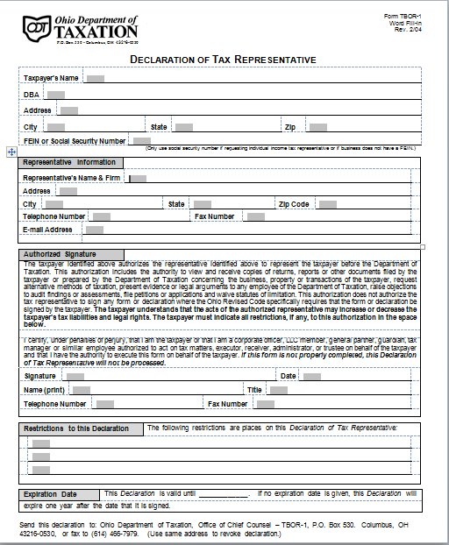
“Who” is Involved in a Sales/Use Tax Audit
Representing the Department
Representing the taxpayer
    Lead tax auditor
    Additional staff
      Auditor’s manager
      Additional staff if needed
    Taxpayer
    Outside Representation

Slide 8
“Why” Does a Sales/Use Tax Audit
Occur
The “Audit” Lottery
A recent law change
The industry your company is in and the confusion regarding application of the law
    Manufacturing
    Construction
    Service Providers, including
      Doctors and dentists
      Veterinarians
Taxpayer’s filing history and/or lack thereof
Refund requests
Every taxpayer has an equal opportunity to have their sales/use tax filing history reviewed every three years

Slide 9
“When” Will I Know About a Sales/Use Tax Audit
1st Contact
    Telephone Call
    Audit Commencement Letter
Preliminary meeting
    Explain the audit in detail
Record Review
Preliminary Deficiency Listing Review
Final Review Meeting, including
    Recommendation of Assessment
    Letter of Confirmation
Assessment

Slide 10
“Where” Does a Sales/Use Tax Audit Take Place
Preliminary meeting
    Conducted at taxpayer’s facility because
        Facility tour will need taken, if necessary
Record review
    At Taxpayer’s facility, or
    At Tax Reps office (whichever is more convenient), or
    If records are available electronically, remote review work
Preliminary and Final Reviews
    In person at either Taxpayer’s facility, or
    At Tax Reps office

Slide 11
“How” Long Does a Sales/Use Tax Audit Take
It Depends…..
All audits take time to review records and compile deficiency listings
Sales audits require the allowance of 120-days to obtain a full-completed exemption certificate or letter of usage should the original be denied
A waiver may need to be executed

Slide 12
“How” is a Sales/Use Tax Audit Completed
Sales Audits
    Review of Returns
    Review of Exemption Certificates
    120-day Letter Process
Use Audits
    Capital
    Expenses
    Other Transactions
        Leases
        Credit Cards (P-cards, A-cards)
        Prepaids
        Journal Entries
        Brokered Natural Gas

Slide 13
“How” is a Sales/Use Tax Audit Completed
The following items are requested of all sales/use tax audits:
    Chart of Accounts
    Trial Balances
    Organizational Structures/Chart
Sales audits may also include a request for returns
Use audit may also include a request for capital acquisition listings
All Sales/Use Tax audits are completed electronically
A complete copy of the file is available via Secure File Transfer

Slide 14
“How” is a Sales/Use Tax Audit Completed
Methodologies to review the data include:
    Comprehensive Review
    Block Sampling
    Statistical Sampling
    Probe Sampling
Liquor Mark-ups
Quick Service Restaurants
Bars and Restaurants

Slide 15
Miscellaneous Information
Ask for and stick to the audit plan
If an audit liability exists:
    Penalty
    Interest
    Concurrent Responsible Party Assessment
Watch for “Pitfalls”
Don’t ignore deadlines given by the auditor
Don’t ignore written correspondence from the State regarding your audit assessment

Slide 16
Miscellaneous Information
The Key to a Successful Sales/Use Tax Audit
Keep the lines of COMMUNICATION open with the auditor

Slide 17
What to Expect During a Sales/Use Tax Audit
Questions?
Debra Day, Tax Auditor Agent
debra.day@tax.state.oh.us
614-800-3950
William Bower, Tax Audit Manager
william.bower@tax.state.oh.us
614-387-2039

